Slide 1
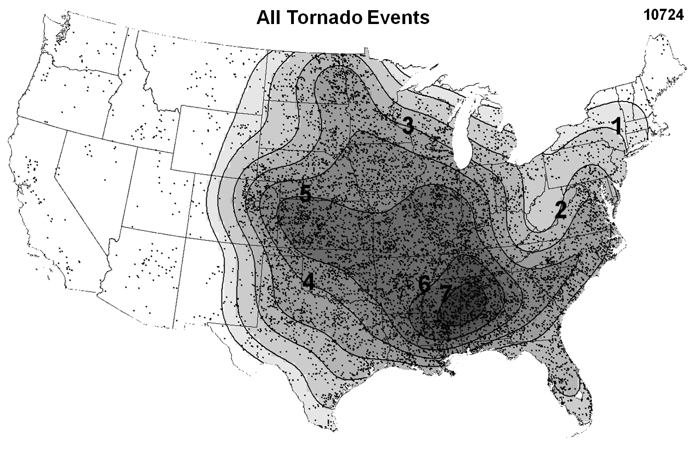
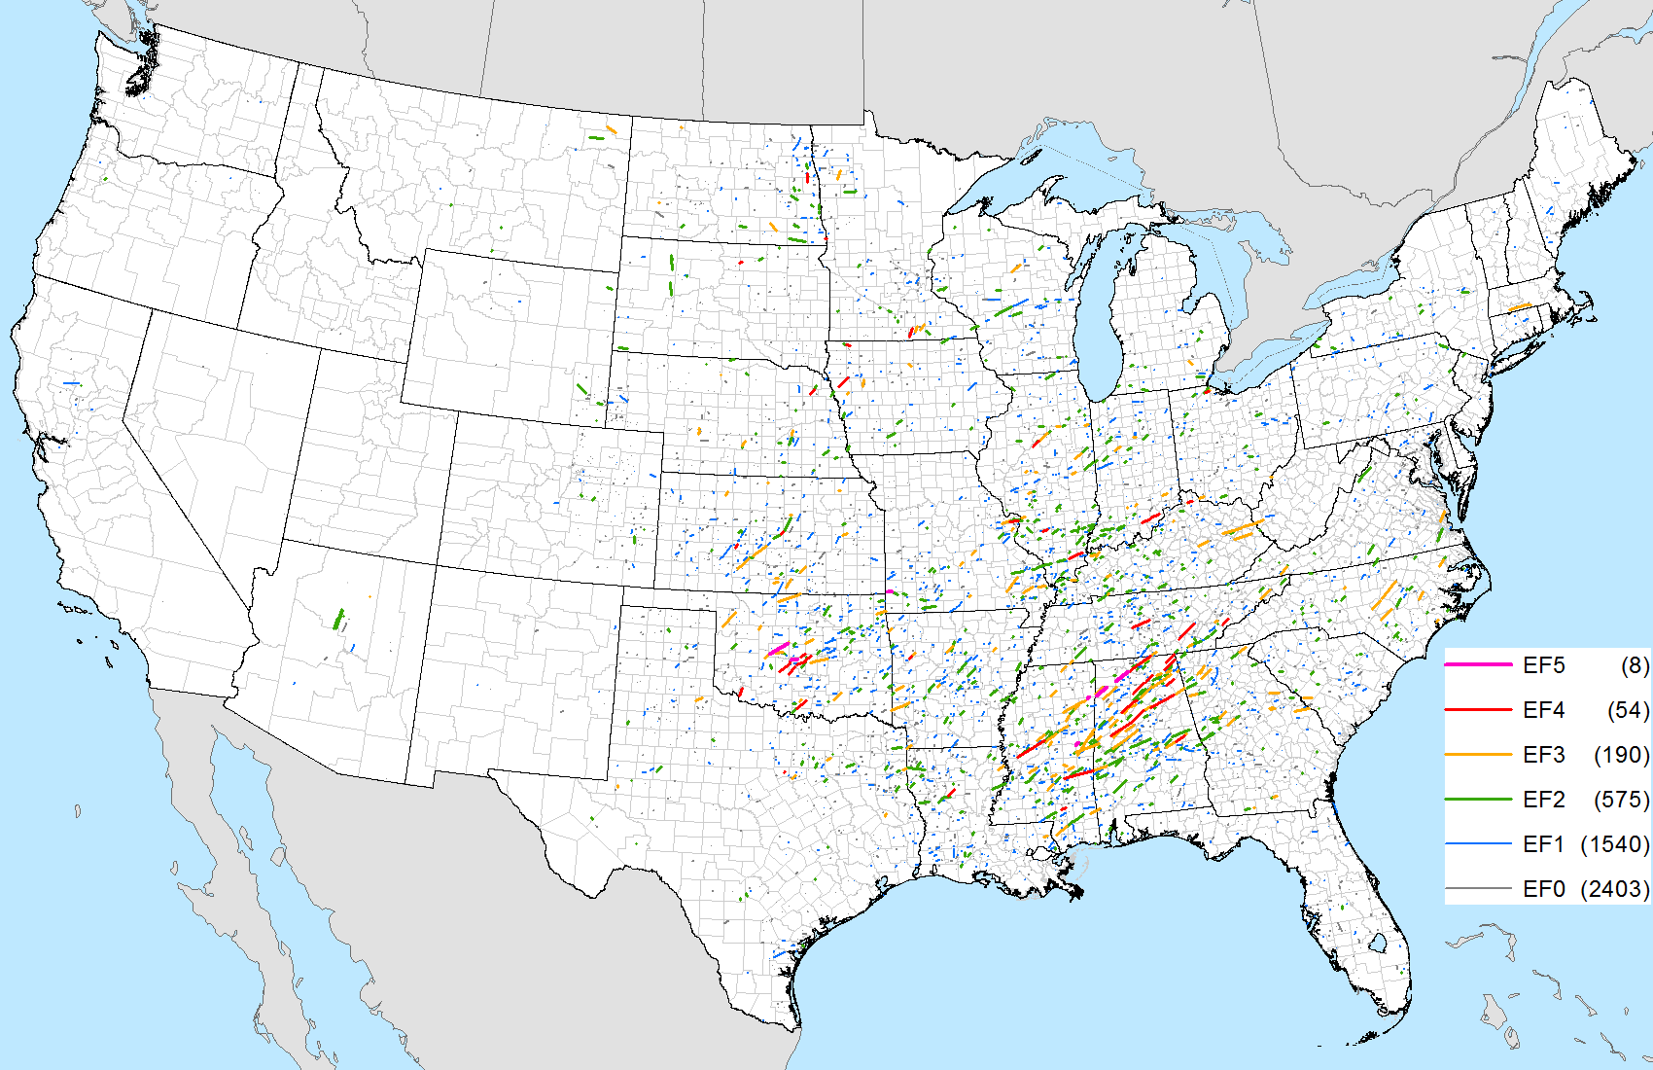
Tornado Climatology
Notes:
Data from: Thompson et al. 2013, Grams et al. 2012, Thompson et al. 2010

Slide 2
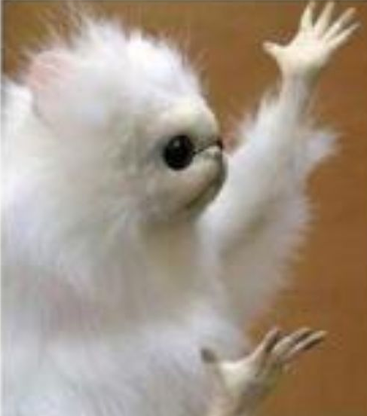
Climatology: Why Should We Care?
I’m here to learn about tornadoes!
What do I care about climatology?!
Being aware of severe weather climatology helps us establish a baseline of what’s “normal”.
In turn, this allows us to identify
anomalous environments
(whether anomalously low or high).
Notes:
Based on parameter space alone, the 2% tornado threat appears appropriate.

Slide 3
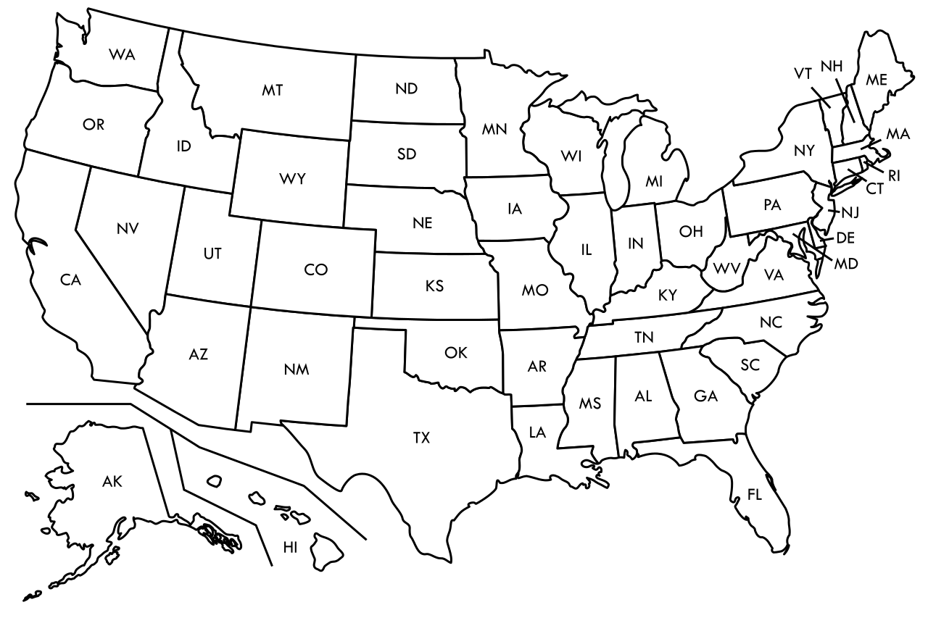
MLCAPE = 2000 J/kg
A
MLCAPE of 2000 J/kg is most
common for which location?
Is it common for this time of year?
Is it common for environments associated with tornadoes?
C
B
D
Notes:
Based on parameter space alone, the 2% tornado threat appears appropriate.

Slide 4
MLCAPE = 3000 J/kg
It’s mid-May with an
MLCAPE of 3000 J/kg and a dryline across western OK.
Is this a higher than normal risk for severe thunderstorms?
Notes:
Based on parameter space alone, the 2% tornado threat appears appropriate.

Slide 5
MLCAPE = 3000 J/kg
Understanding climatology can help answer these questions!
Notes:
Based on parameter space alone, the 2% tornado threat appears appropriate.

Slide 6
Tornado Climatology
Work done by SPC forecasters to identify tornado/ingredient climatologies
Smith et al. 2012 (Weather and Forecasting)
Thompson et al. 2012 (Weather and Forecasting)
Grams et al. 2012 (Weather and Forecasting)
Looked at ~10,000 tornado cases
Period: 2003-2011
Considered Supercell EF-2+ and QLCS EF-1+
Assigned storm mode based on WSR-88D data
Ex: discrete supercell, QLCS, cluster supercell, etc…
Collected SPC Mesoanalysis data for each instance at the nearest grid point
Created plots of tornado events and ingredients based on:
Seasonal (spring, summer, fall, winter)
Convective mode
Notes:
Based on parameter space alone, the 2% tornado threat appears appropriate.

Slide 7
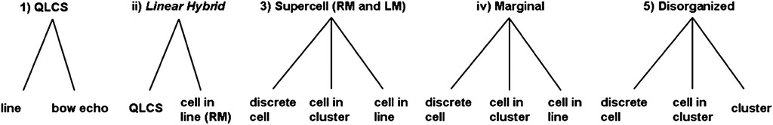
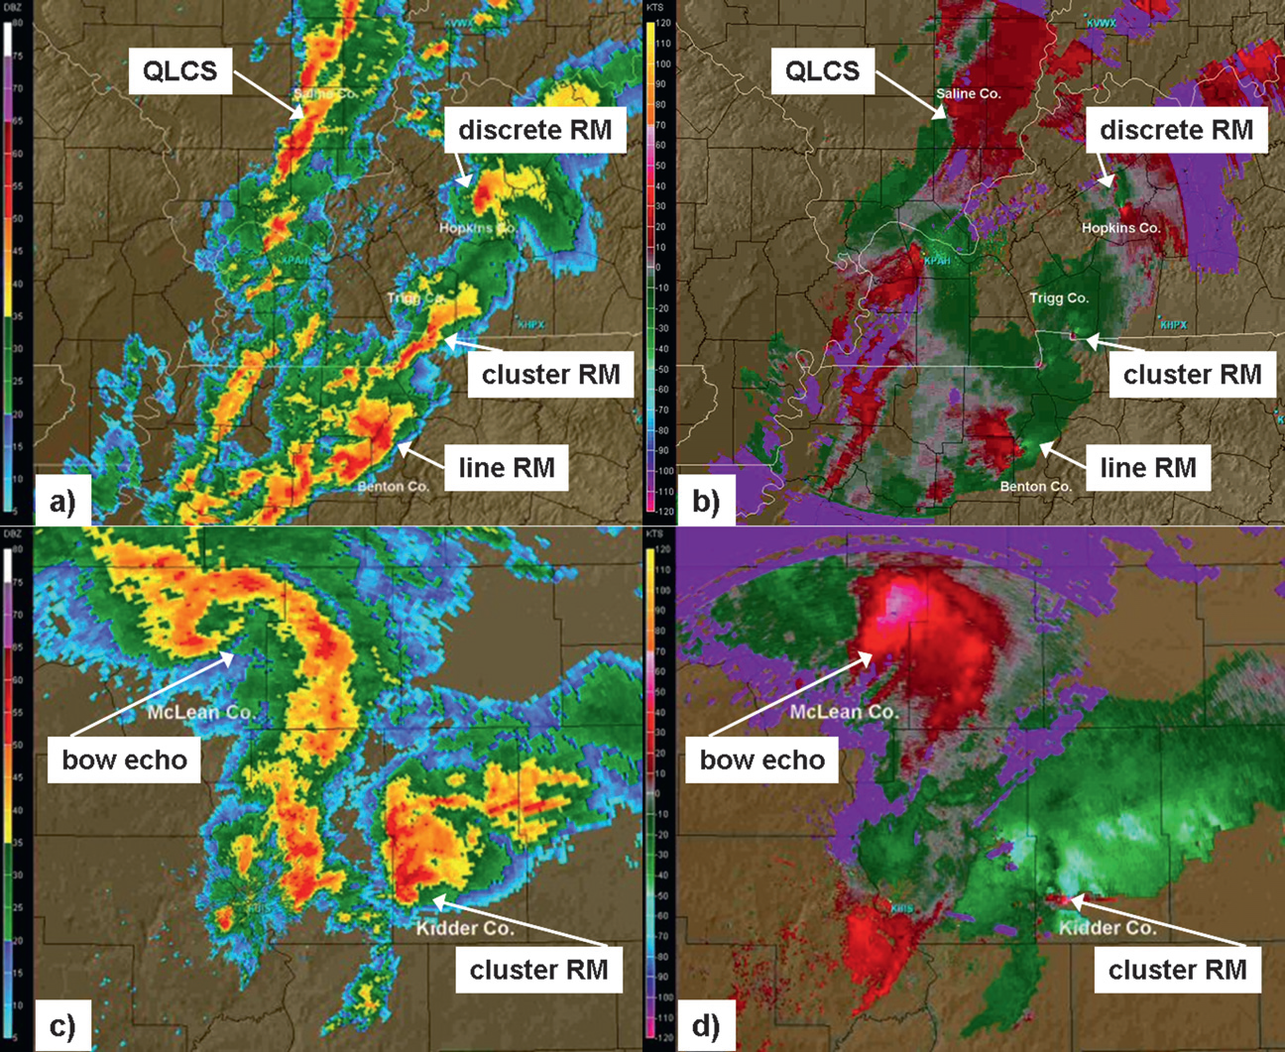
Fig 2. Smith et al. 2012
Fig 3. Smith et al. 2012
Notes:
Based on parameter space alone, the 2% tornado threat appears appropriate.

Slide 8
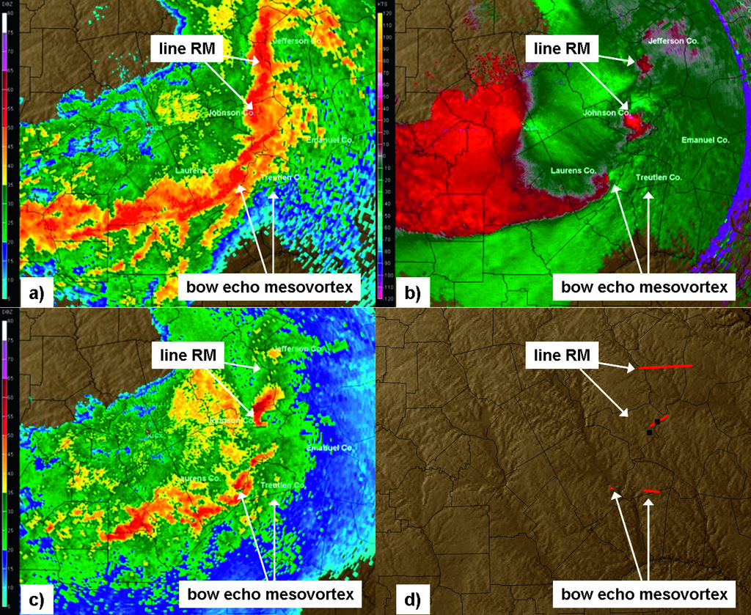
Fig 4. Smith et al. 2012
Notes:
Based on parameter space alone, the 2% tornado threat appears appropriate.

Slide 9
Ingredient Climatology
Considered tornado environments for right-moving supercell and QLCS tornado events
Considered seasonal variations in:
MLCAPE
MLCIN
Effective BWD
Effective SRH
MLLCL
STP
Notes:
Based on parameter space alone, the 2% tornado threat appears appropriate.

Slide 10
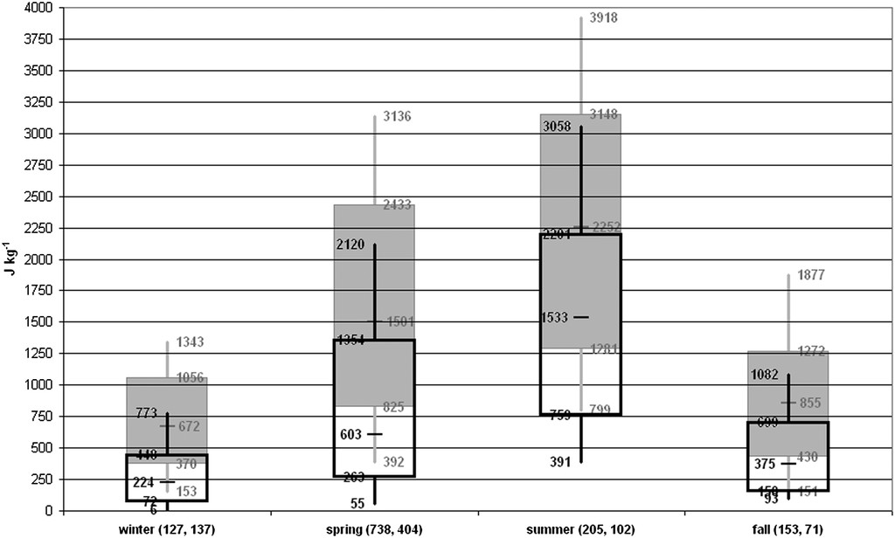
MLCAPE
Consider low-level moisture availability in summer vs. winter.
RM Supercell EF-2+
QLCS EF-1+
Notes:
Based on parameter space alone, the 2% tornado threat appears appropriate.

Slide 11
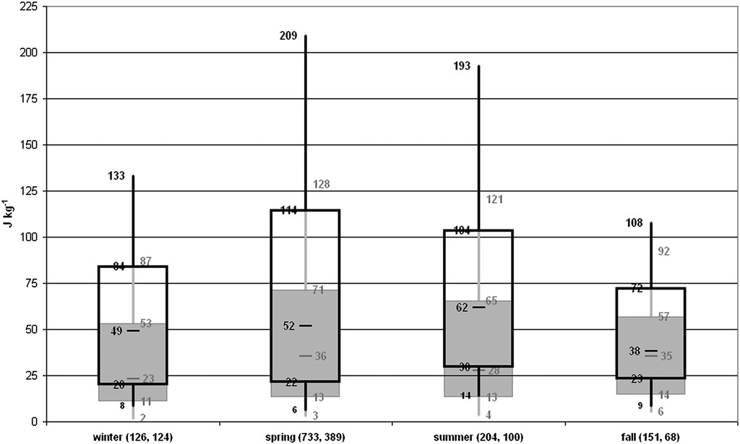
MLCIN
RM Supercell EF-2+
QLCS EF-1+
Notes:
Based on parameter space alone, the 2% tornado threat appears appropriate.

Slide 12
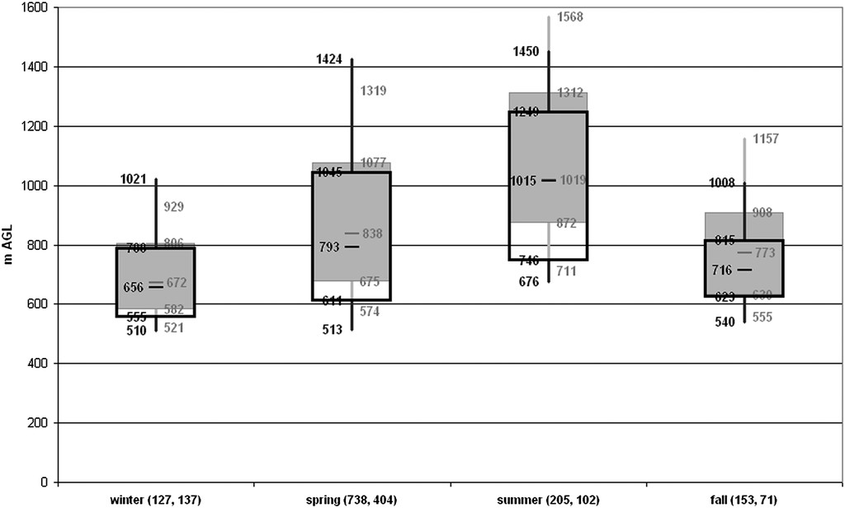
MLLCL
RM Supercell EF-2+
QLCS EF-1+
Consider seasonal temperature trends.
Notes:
Based on parameter space alone, the 2% tornado threat appears appropriate.

Slide 13
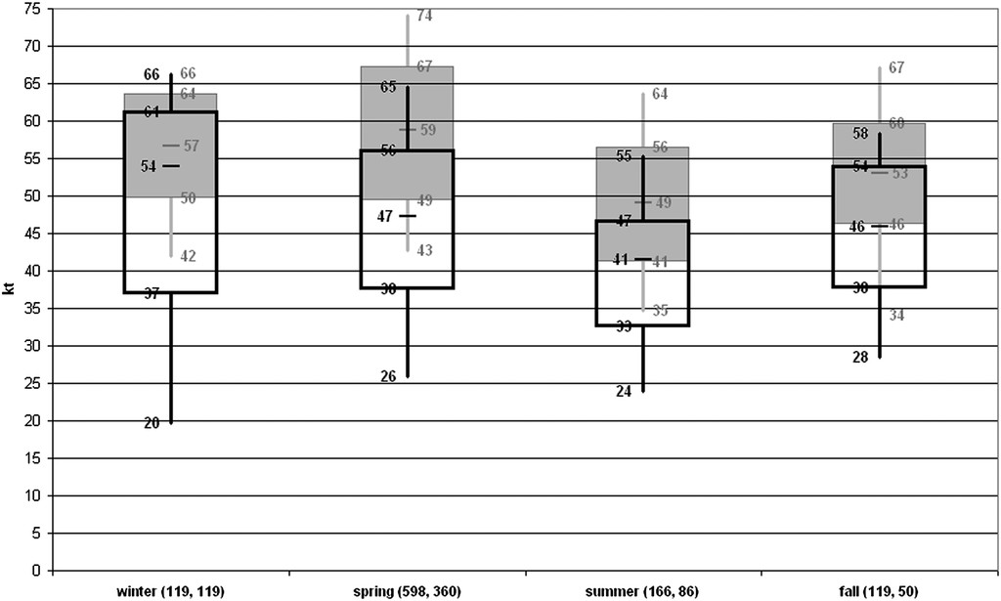
Eff. Bulk Wind Difference
RM Supercell EF-2+
Consider seasonal patterns in the upper-level jet stream
QLCS EF-1+
Notes:
Based on parameter space alone, the 2% tornado threat appears appropriate.

Slide 14
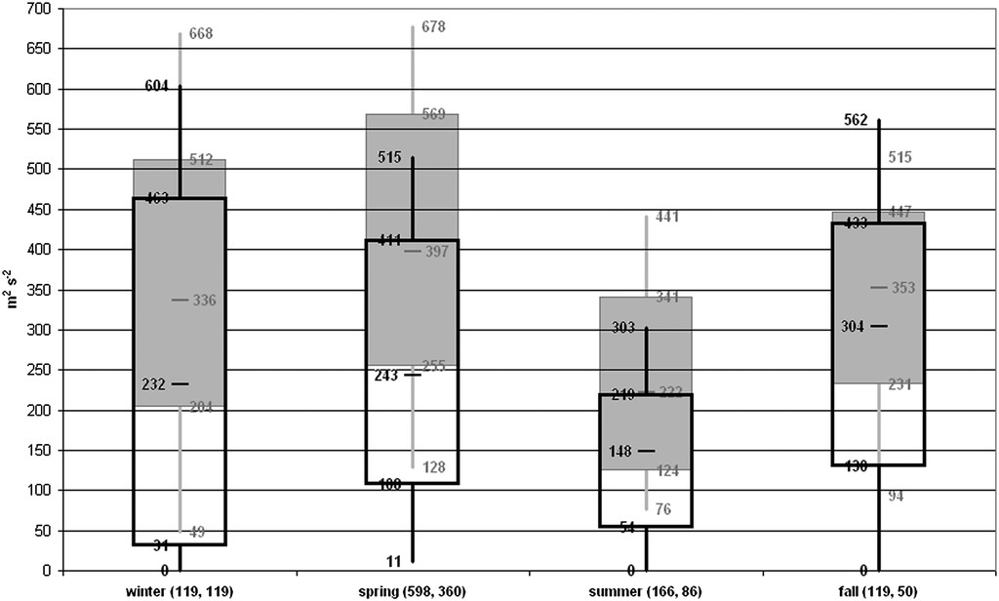
Eff. SRH
RM Supercell EF-2+
QLCS EF-1+
Notes:
Based on parameter space alone, the 2% tornado threat appears appropriate.

Slide 15
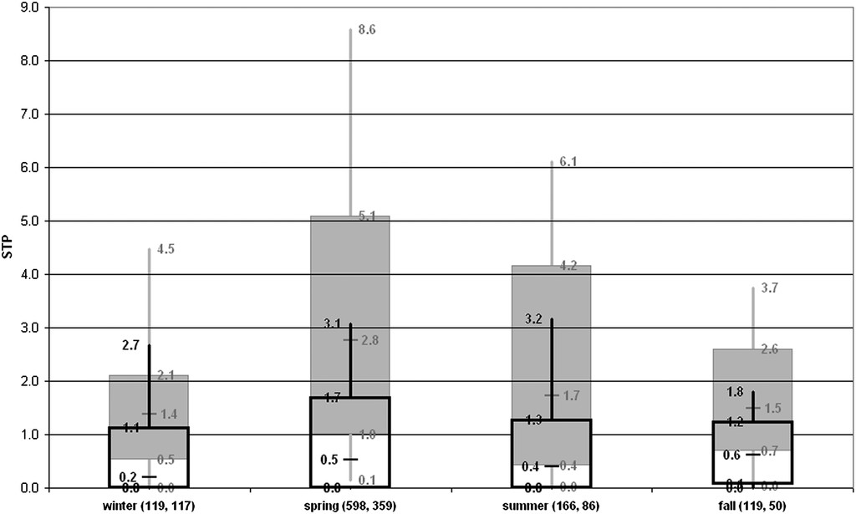
Eff. STP
RM Supercell EF-2+
QLCS EF-1+
Notes:
Based on parameter space alone, the 2% tornado threat appears appropriate.

Slide 16
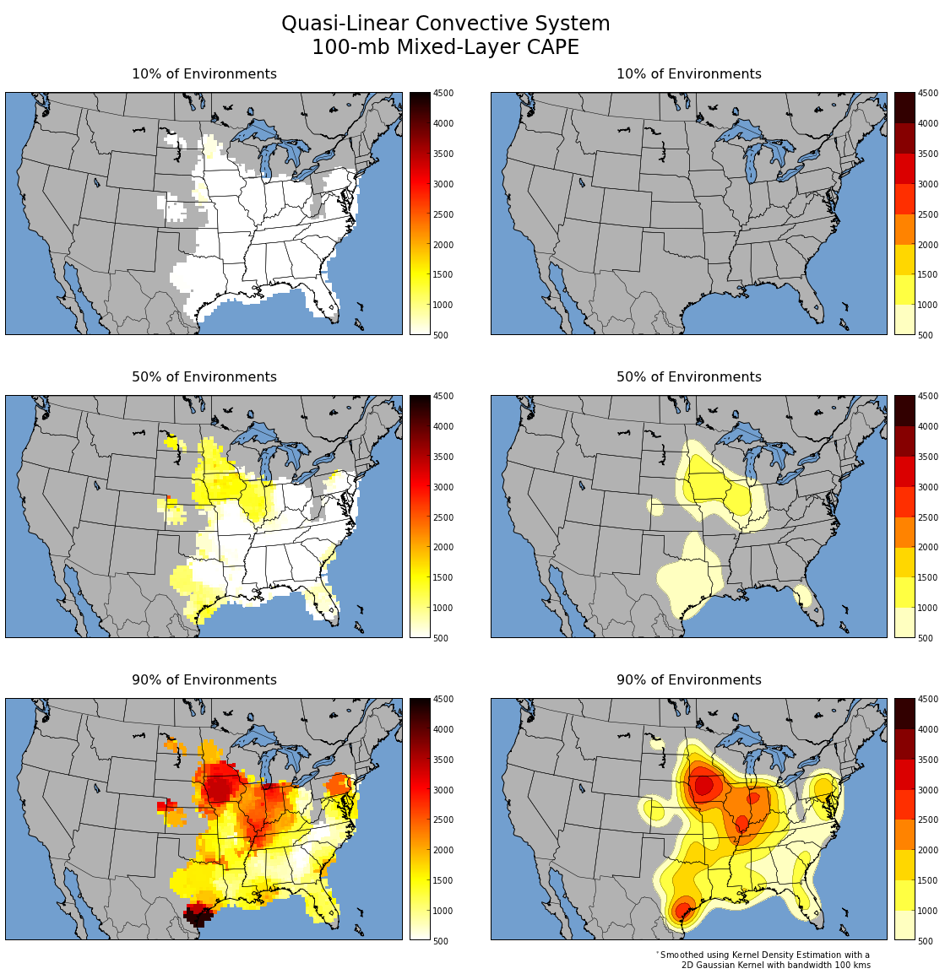
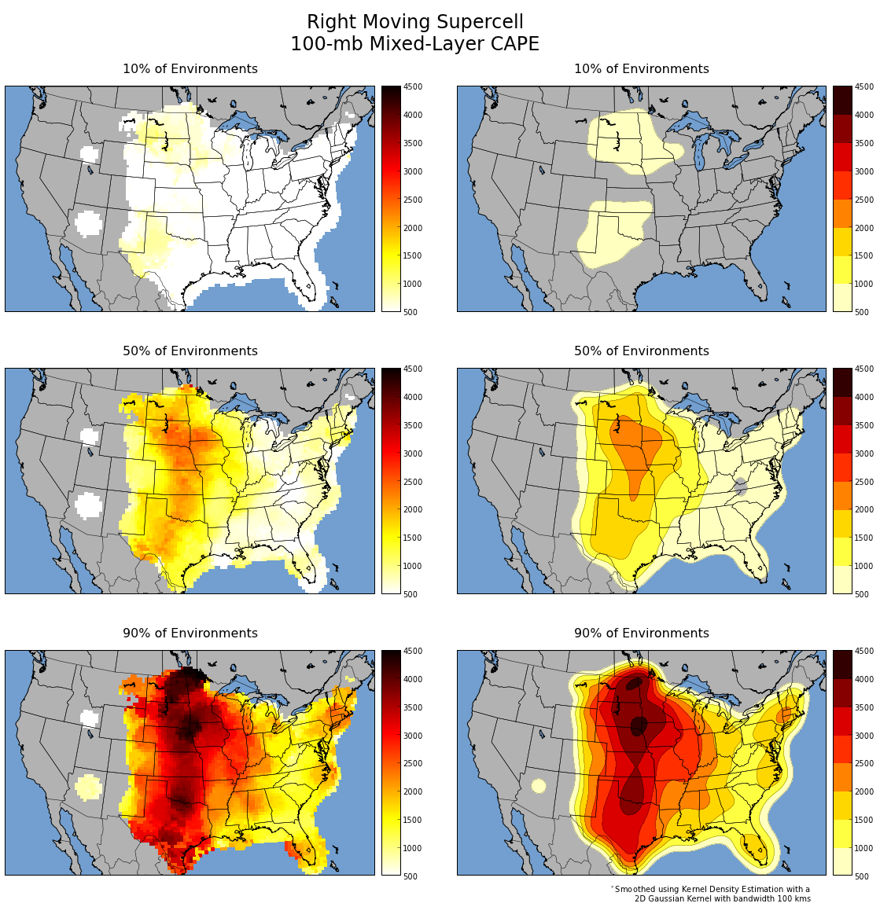
MLCAPE (J/kg)
QLCS
RM Supercell
10th
50th
90th
Notes:
Based on parameter space alone, the 2% tornado threat appears appropriate.

Slide 17
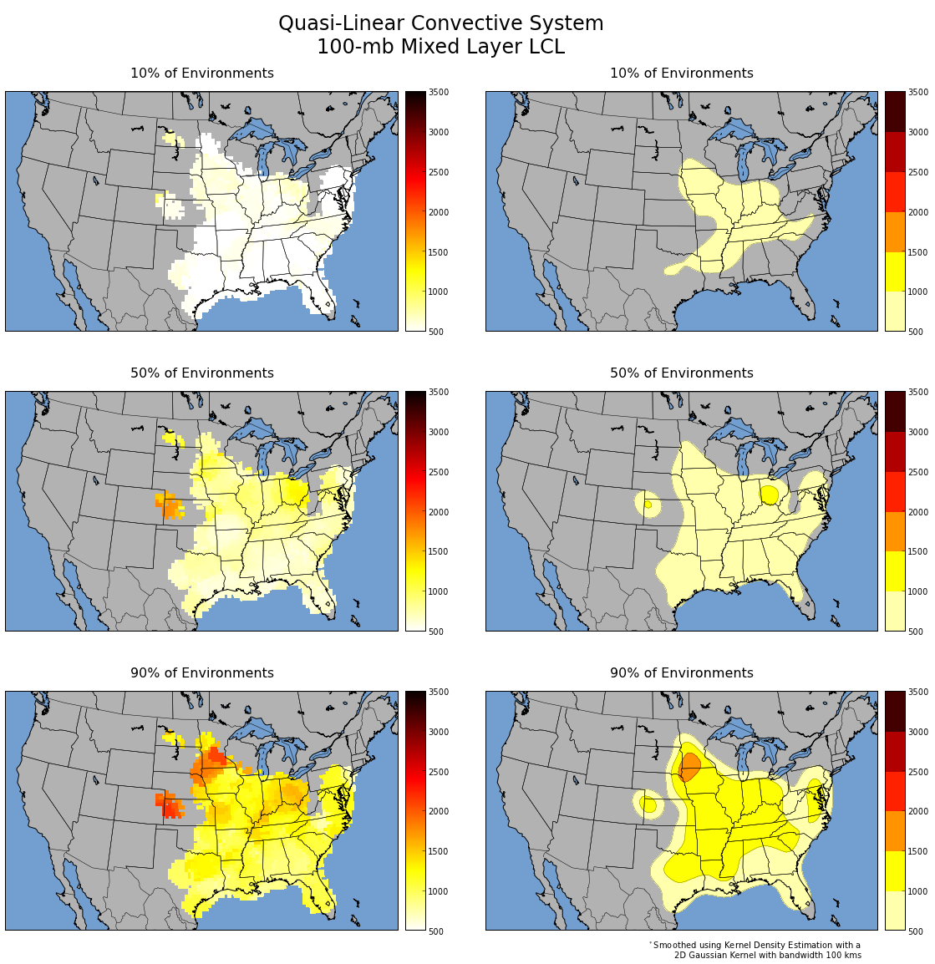
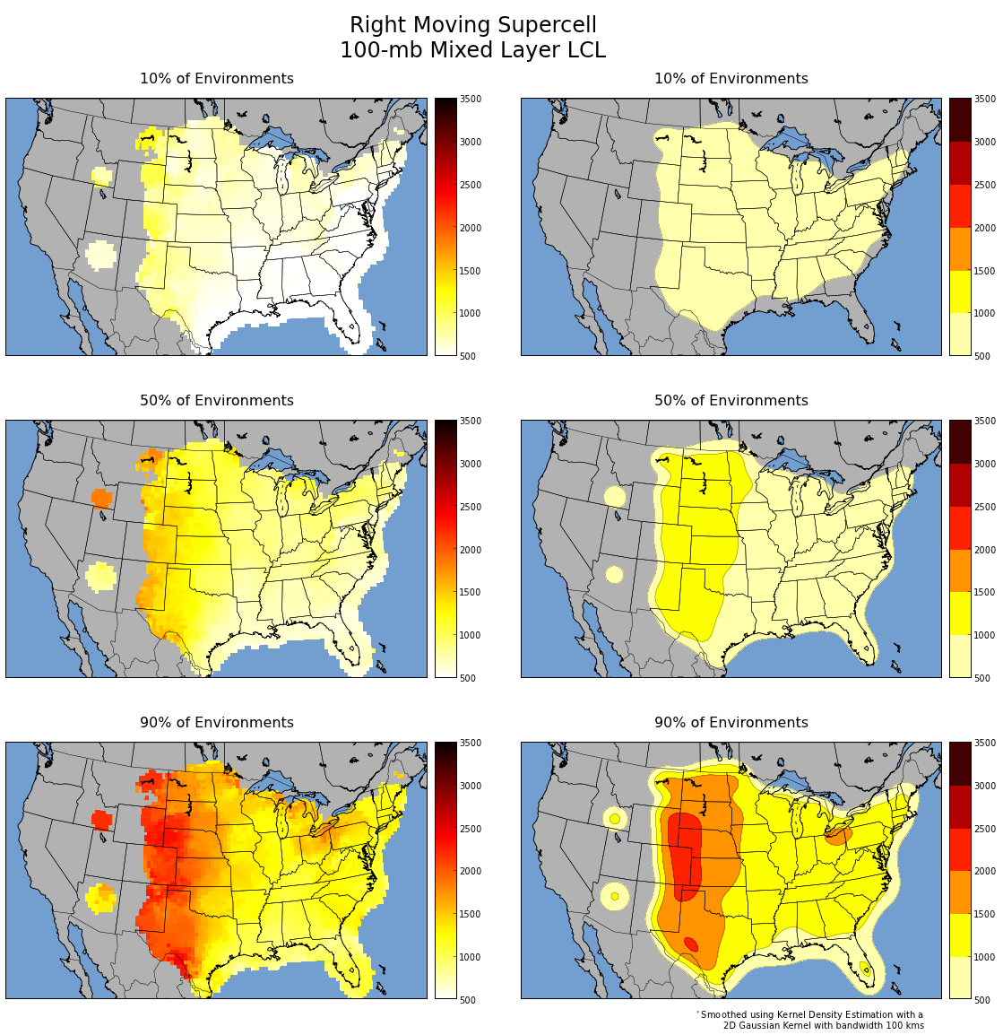
MLLCL (m)
QLCS
RM Supercell
10th
50th
90th
Notes:
Based on parameter space alone, the 2% tornado threat appears appropriate.

Slide 18
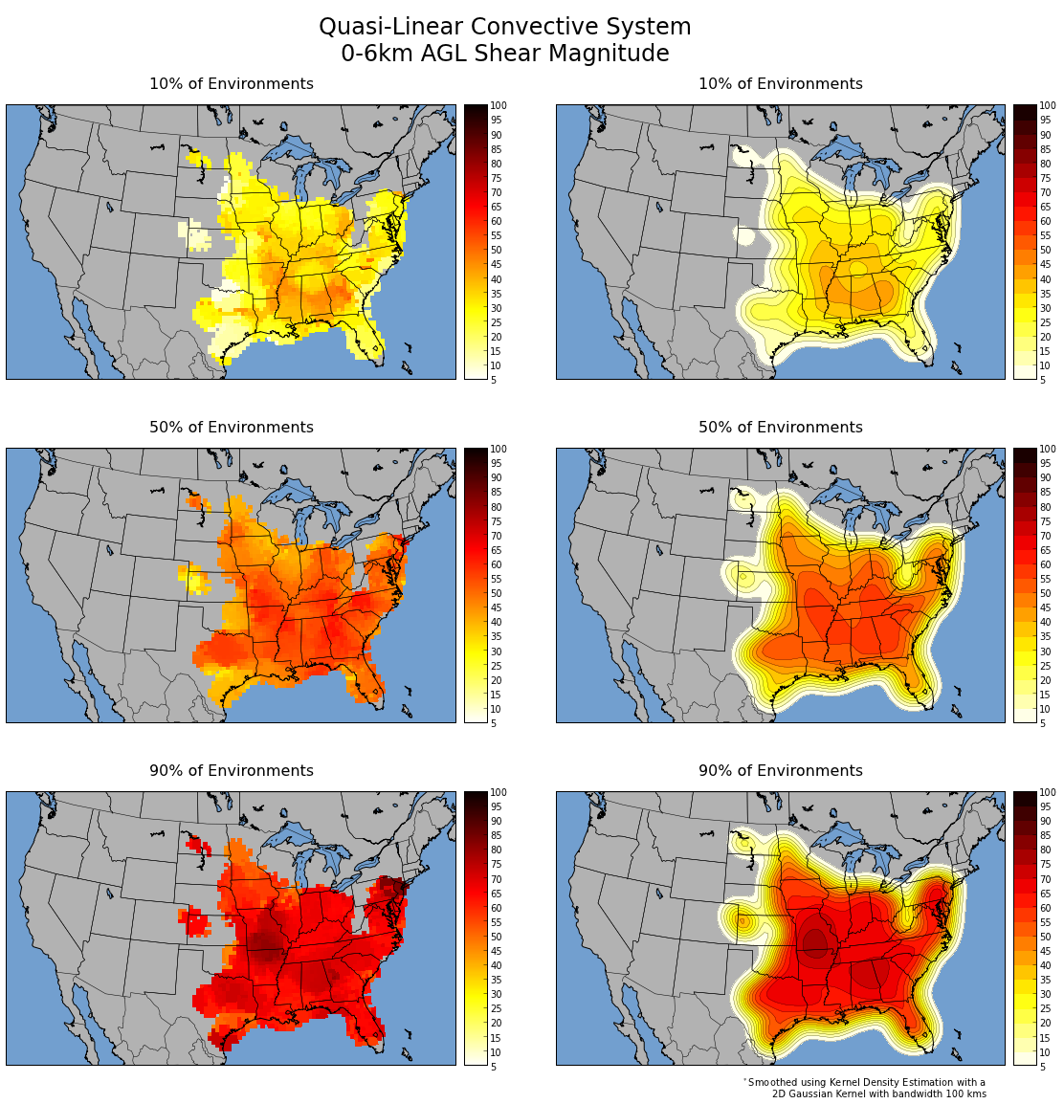
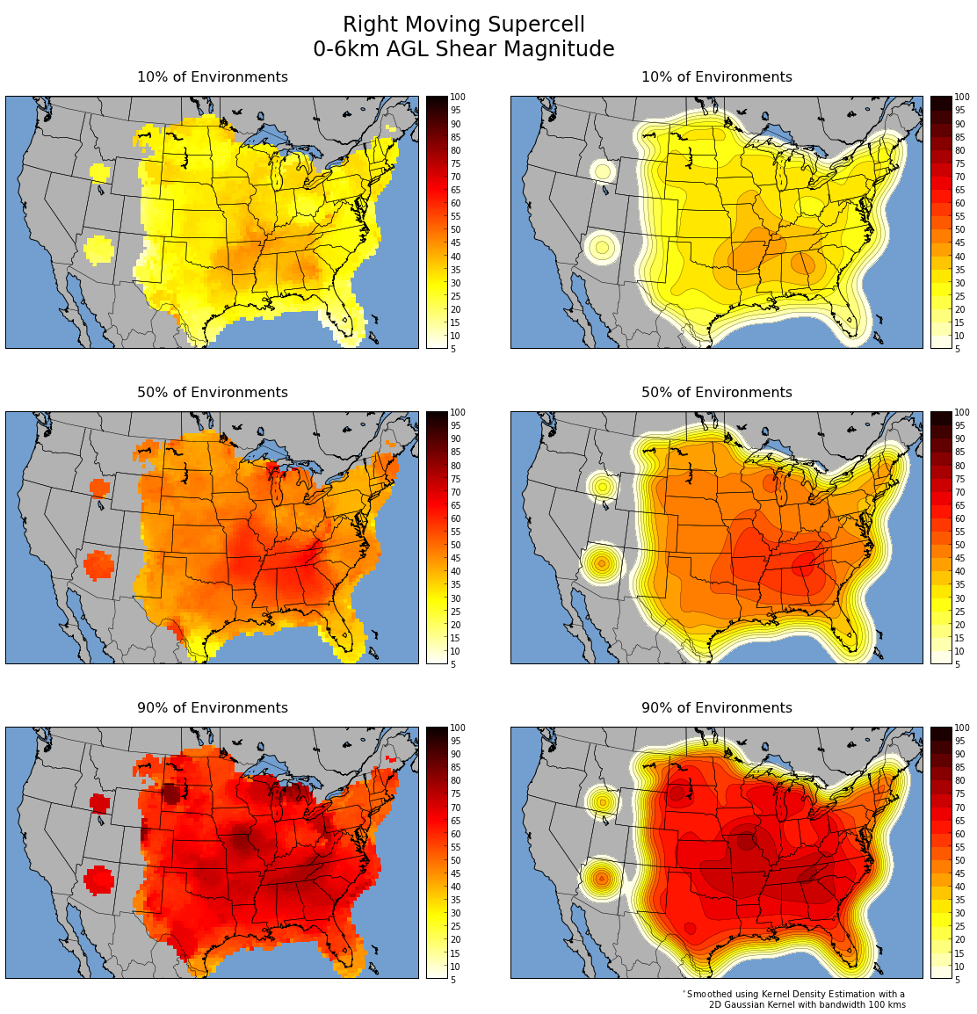
0-6 km Bulk Wind Difference (kt)
QLCS
RM Supercell
10th
50th
90th
Notes:
Based on parameter space alone, the 2% tornado threat appears appropriate.

Slide 19
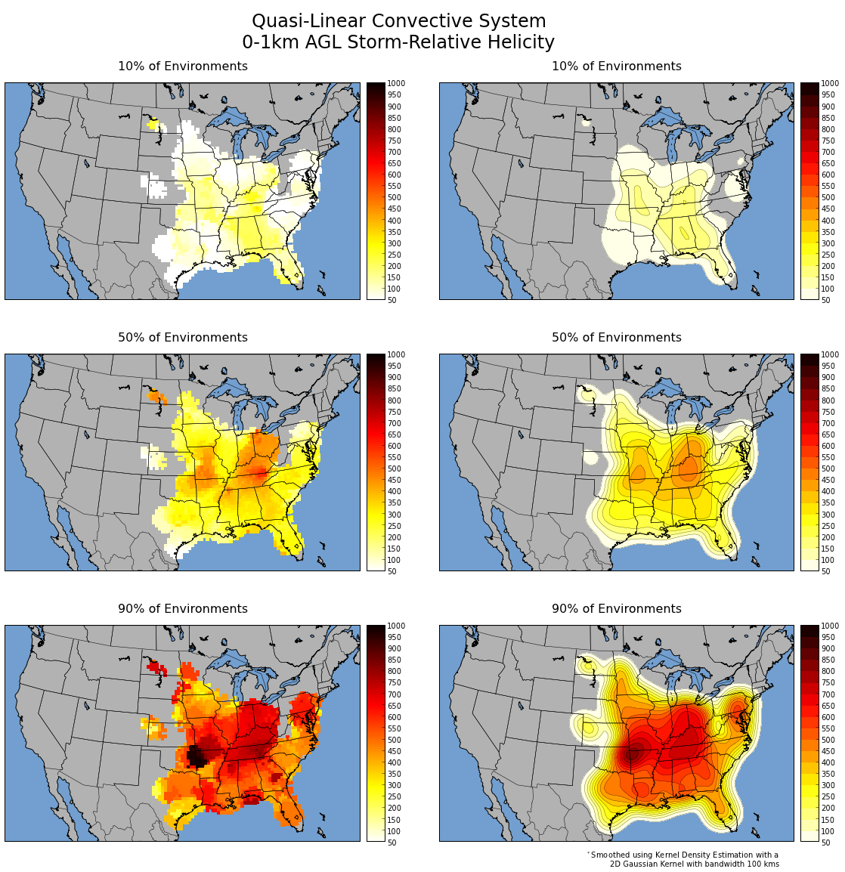
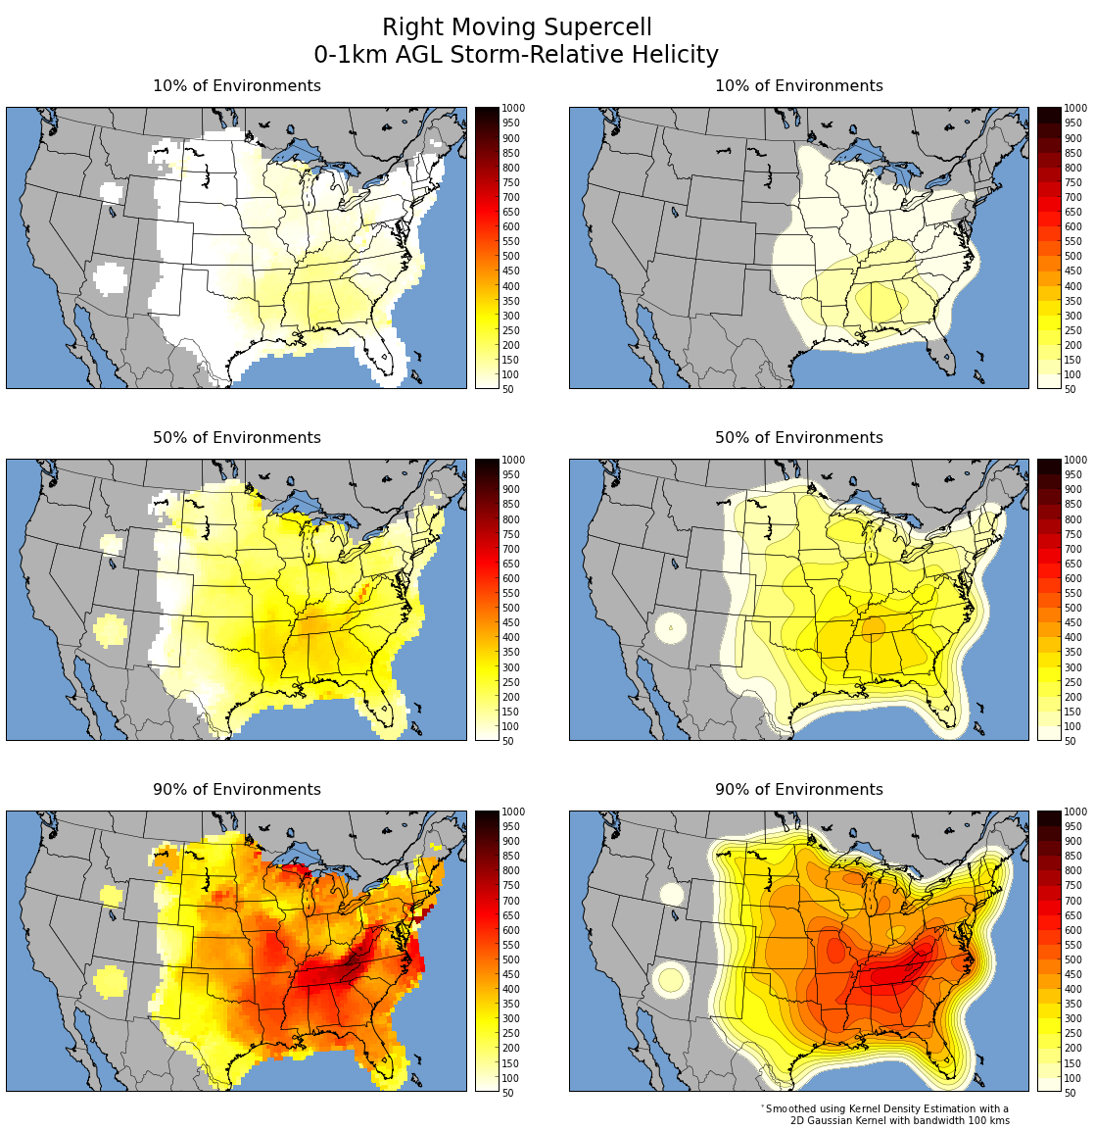
0-1 km SRH (m2/s2)
QLCS
RM Supercell
10th
50th
90th
Notes:
Based on parameter space alone, the 2% tornado threat appears appropriate.

Slide 20
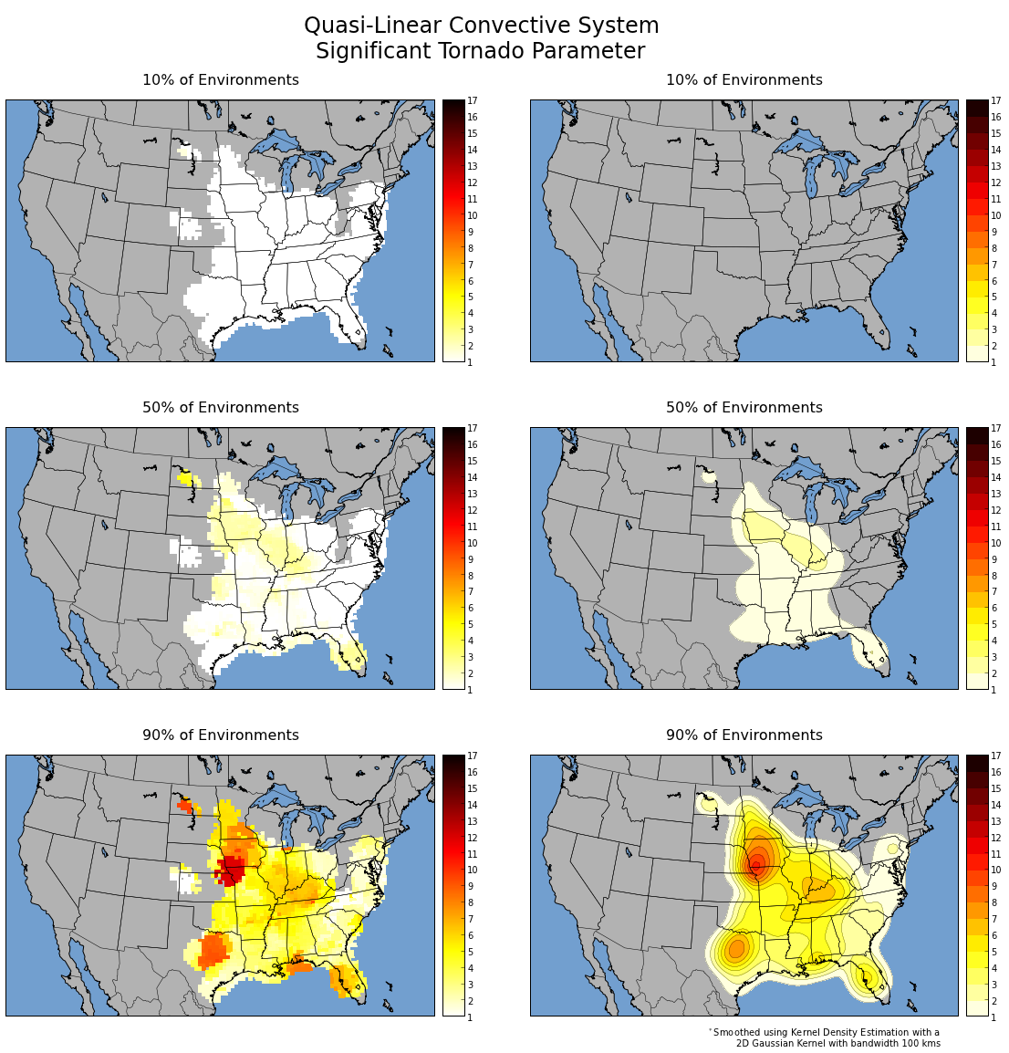
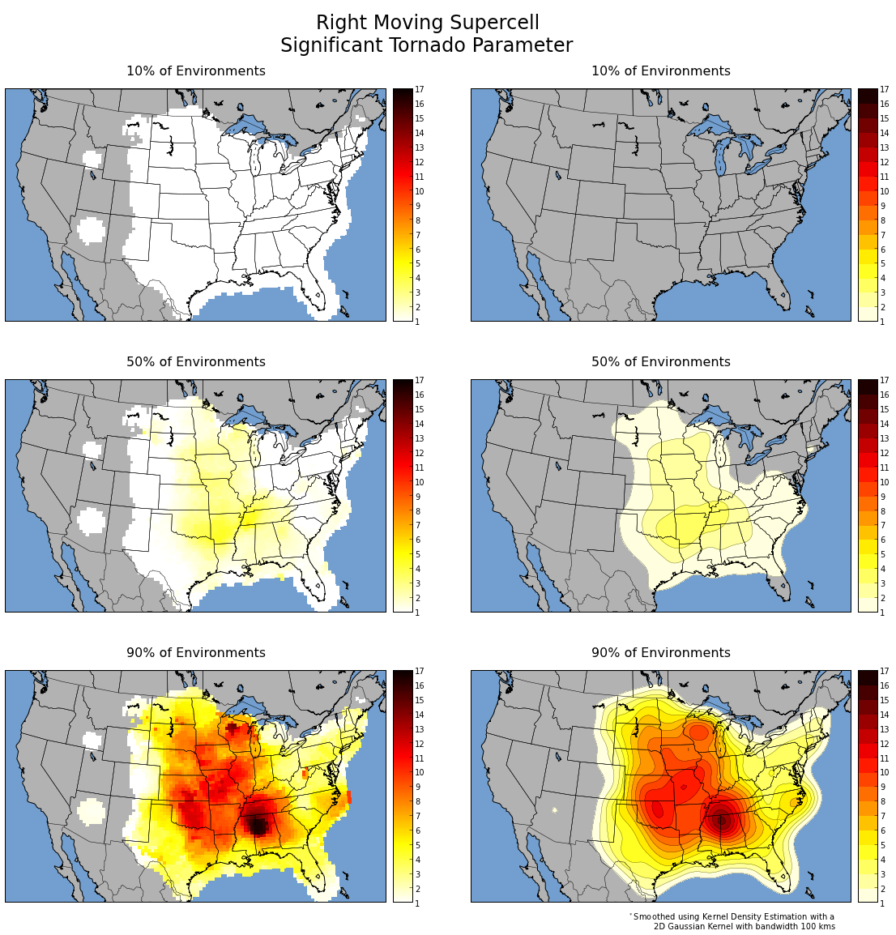
Fixed-Layer STP
QLCS
RM Supercell
10th
50th
90th
Notes:
Based on parameter space alone, the 2% tornado threat appears appropriate.

Slide 21
STP distribution is largely driven by the overlap in MLCAPE and 0-1 km SRH
Supercell MLCAPE
Supercell 0-1 km SRH
Supercell STP
Notes:
Based on parameter space alone, the 2% tornado threat appears appropriate.

Slide 22
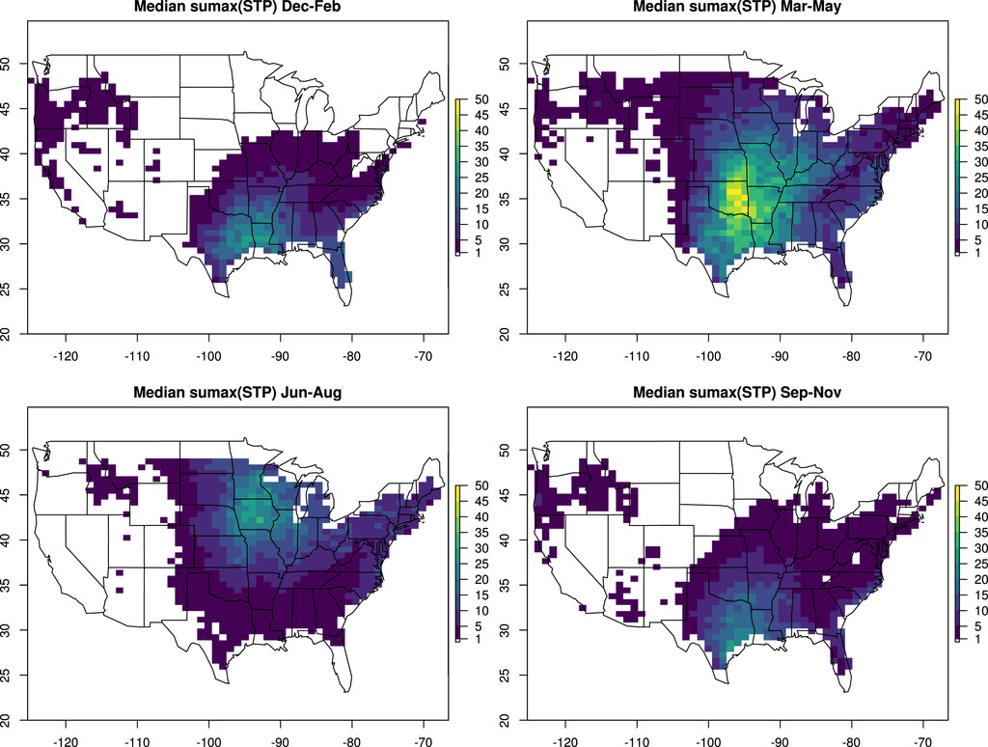
STP distribution is largely driven by the overlap in MLCAPE and 0-1 km SRH
Supercell MLCAPE
Supercell 0-1 km SRH
Supercell STP
From Gensini and Bravo de Guenni 2019
Notes:
Based on parameter space alone, the 2% tornado threat appears appropriate.

Slide 23
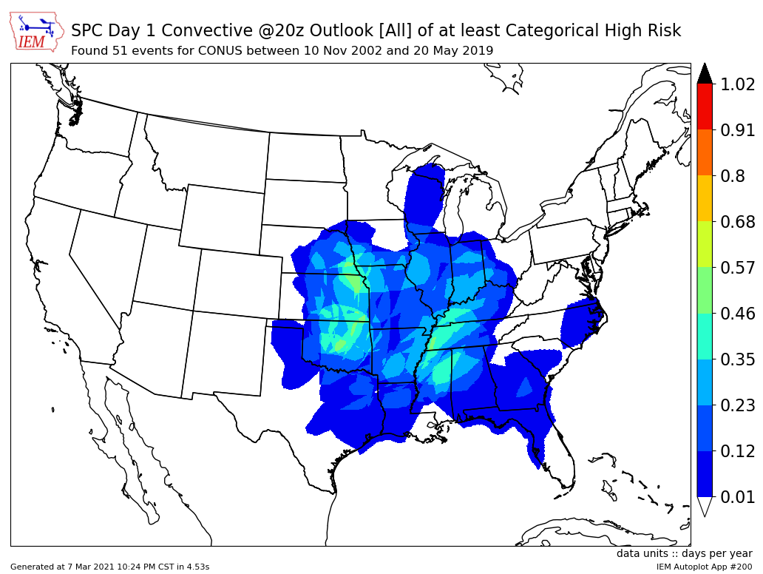
STP distribution is largely driven by the overlap in MLCAPE and 0-1 km SRH
Supercell MLCAPE
Supercell 0-1 km SRH
Supercell STP
Notes:
Based on parameter space alone, the 2% tornado threat appears appropriate.

Slide 24
Ingredients Summary
Clear regional and seasonal variations in tornado ingredients
Seasonal variations are physically tied to other seasonal trends (ex: temp)
Regional variations in thermodynamic parameters between Supercell and QLCS
Larger CAPE and higher LCL heights for supercells in the Plains
Vertical shear is similar spatially for Supercell and QLCS tornadoes
Slightly greater wind shear in MS/TN Valleys
Notes:
Based on parameter space alone, the 2% tornado threat appears appropriate.

Slide 25
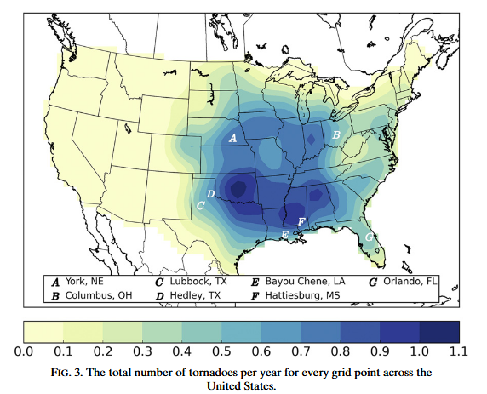
Overall Frequency:
Tornadoes/year
Notes:
Based on parameter space alone, the 2% tornado threat appears appropriate.

Slide 26
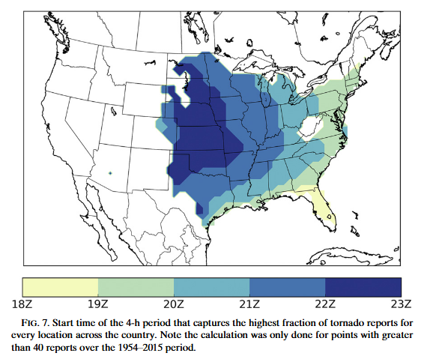
Diurnal Trend
Start time of the 4-hour period that captures the highest fraction of tornado reports.
(Requires N > 40)
See also:
Krocak and Brooks 2020 (WAF)
Notes:
Based on parameter space alone, the 2% tornado threat appears appropriate.

Slide 27
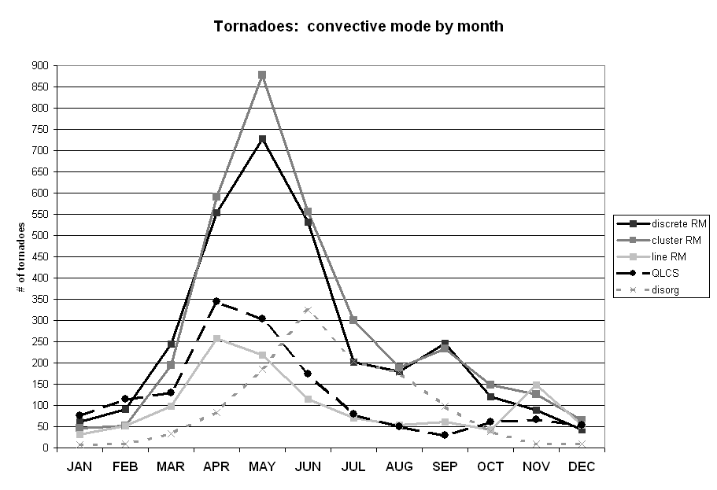
Notes:
Based on parameter space alone, the 2% tornado threat appears appropriate.

Slide 28
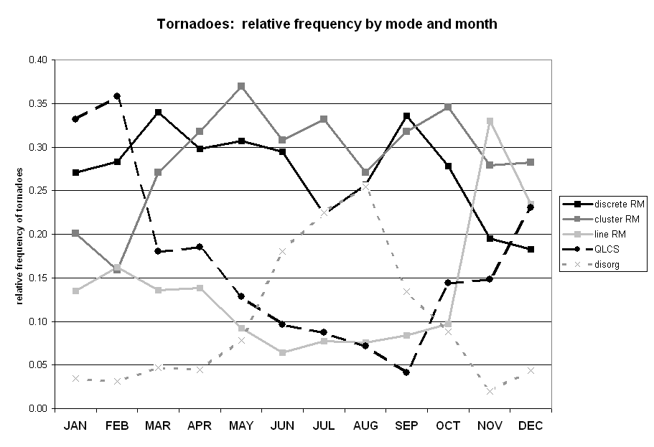
Notes:
Based on parameter space alone, the 2% tornado threat appears appropriate.

Slide 29
Supercell Tornadoes tend to dominate throughout the year
Notes:
Based on parameter space alone, the 2% tornado threat appears appropriate.

Slide 30
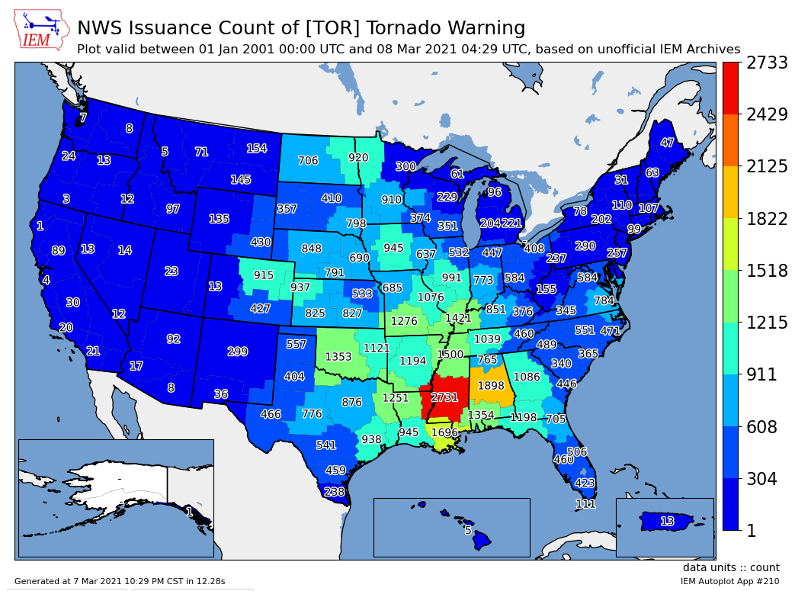
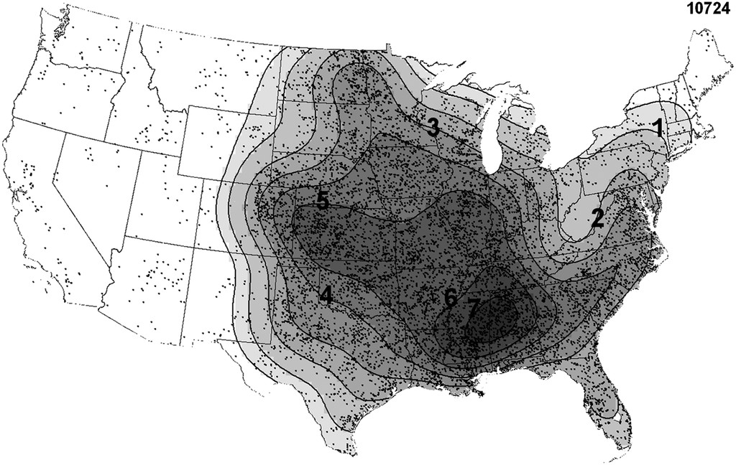
Tornado Events per Decade
This result is supported well by the number of tornado warnings issued over the past 20 years
(Though these datasets are not entirely independent…)
Notes:
Based on parameter space alone, the 2% tornado threat appears appropriate.

Slide 31
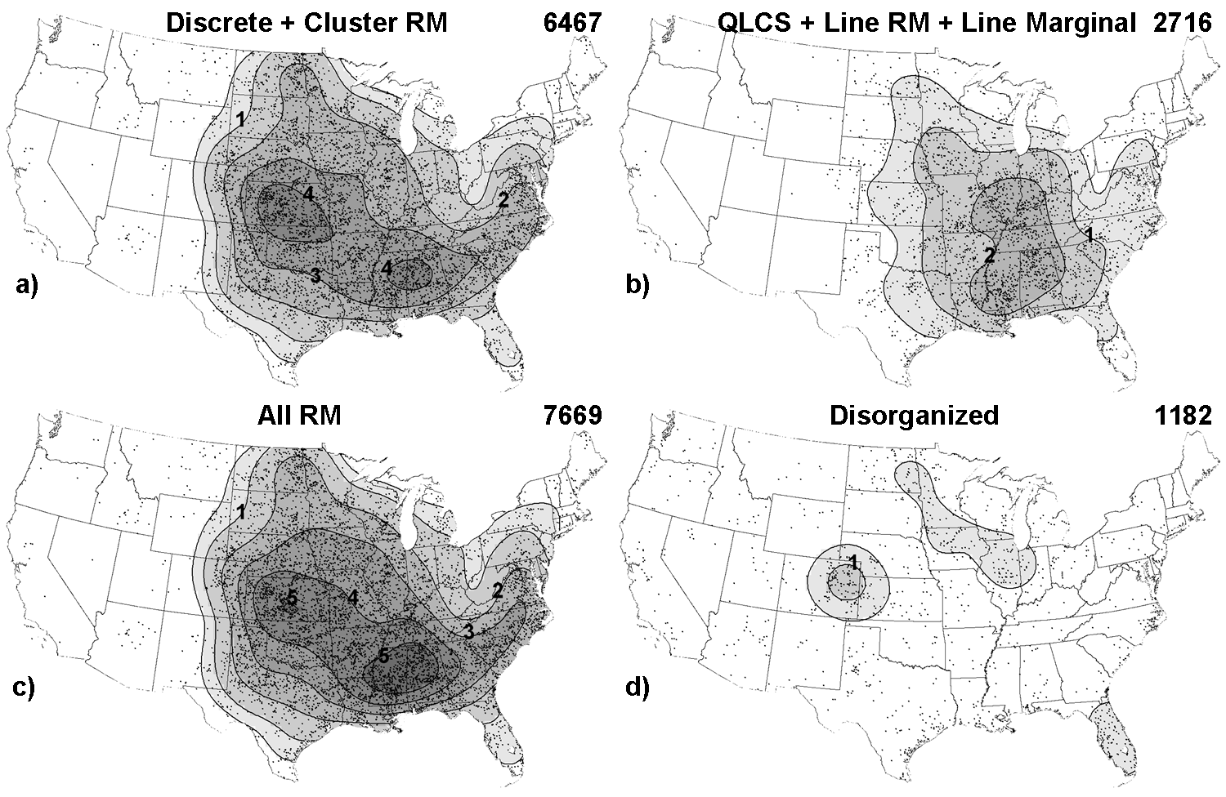
Tornado Events per Decade
Notes:
Based on parameter space alone, the 2% tornado threat appears appropriate.

Slide 32
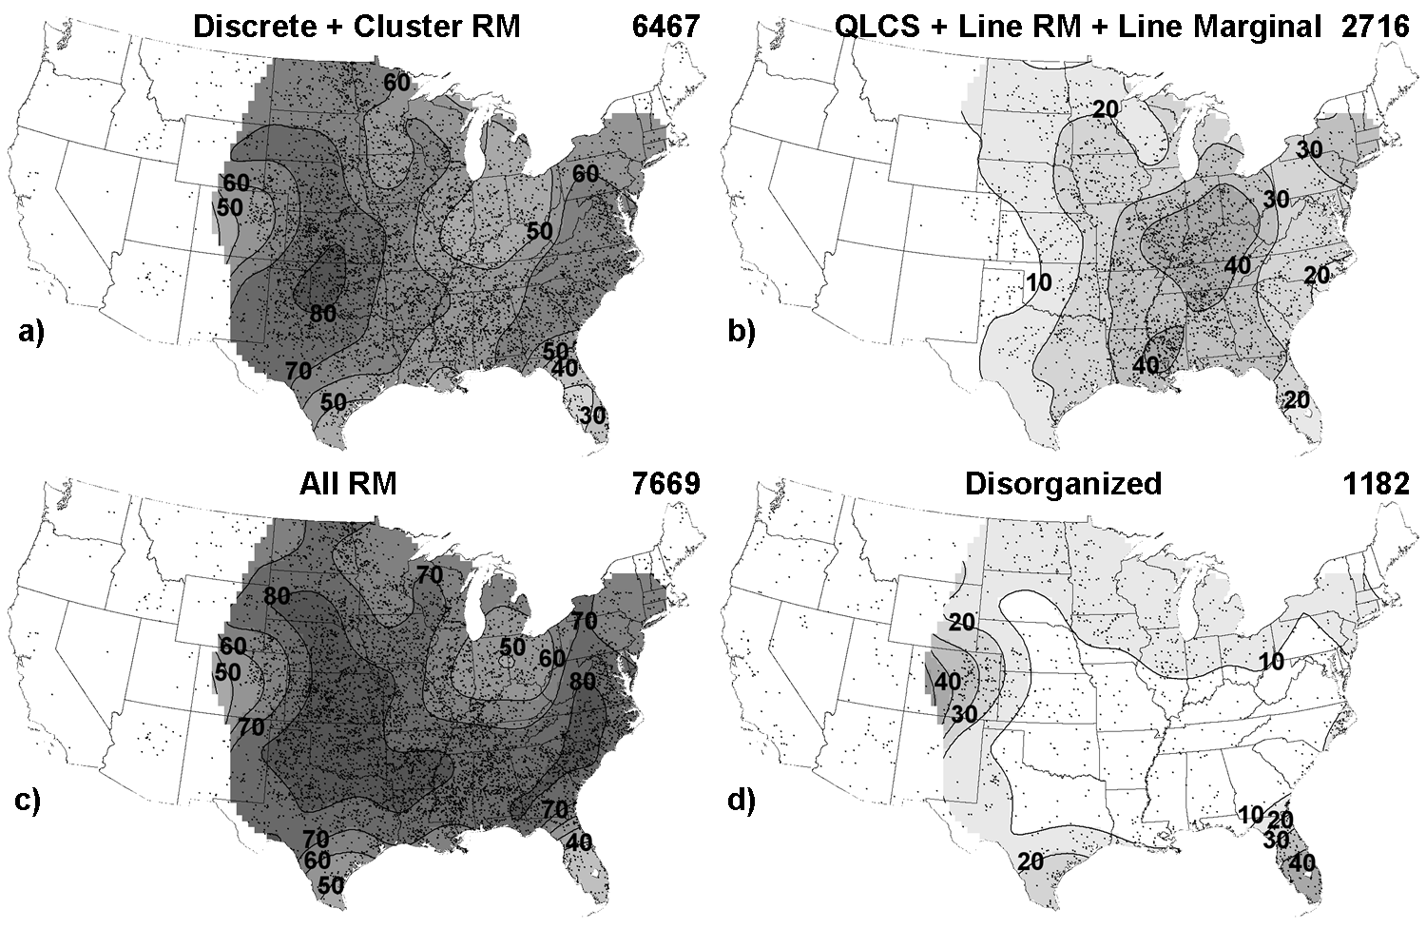
Tornado Relative Frequency
Notes:
Based on parameter space alone, the 2% tornado threat appears appropriate.

Slide 33
Tornado Relative Frequency
Why do we see this shift in distribution?
Notes:
Based on parameter space alone, the 2% tornado threat appears appropriate.

Slide 34
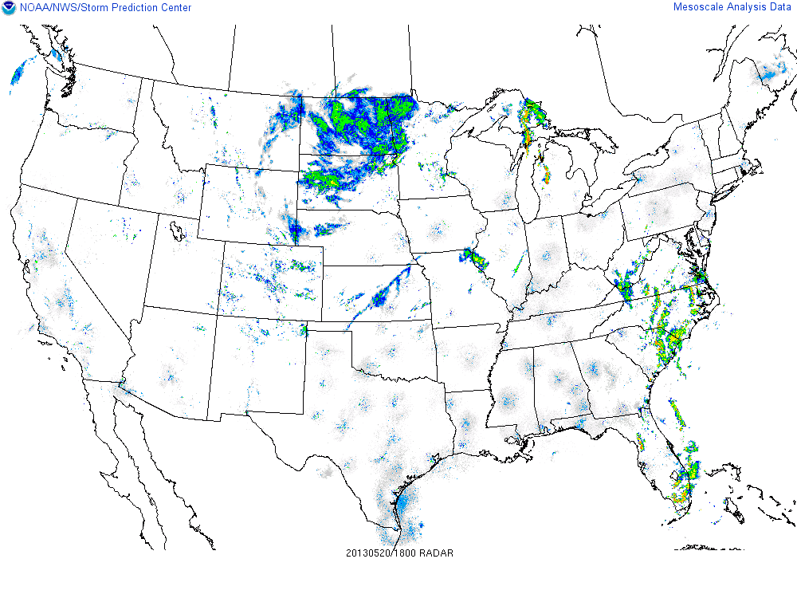
Tornado Relative Frequency
Discrete over the Plains transitions to linear mode over the MS Valley
Notes:
Based on parameter space alone, the 2% tornado threat appears appropriate.

Slide 35
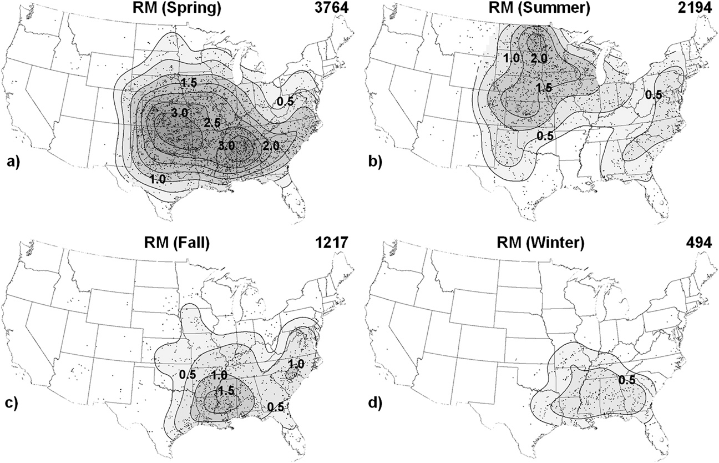
RM Supercell Tornadoes by Season
Notes:
Based on parameter space alone, the 2% tornado threat appears appropriate.

Slide 36
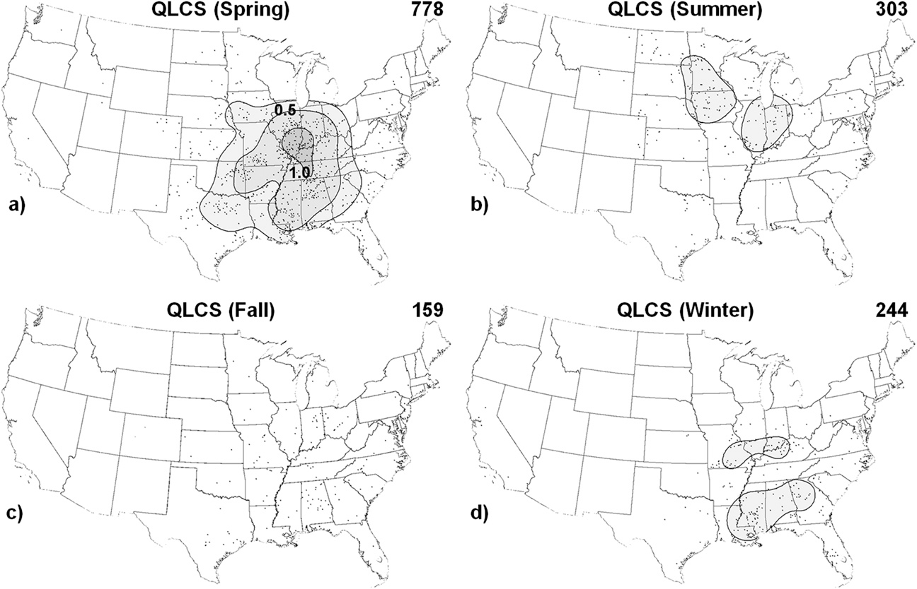
QLCS Tornadoes by Season
Notes:
Based on parameter space alone, the 2% tornado threat appears appropriate.

Slide 37
Tornado Climatology Summary
Tornadoes tend to occur more frequently across the southern Plains and northern Gulf states
Typically occur mid/late afternoon over the central CONUS, but can occur at any time of day.
Associated STP values tend to be higher in this region - suggesting a favorable tor environment
Supercell tornadoes tend to dominate the distribution
Can occur over a wider range of the eastern 2/3rds of the CONUS compared to QLCS tornadoes
Favored over the Plains in the spring, but can occur throughout the year across the CONUS.
Spring maxima is due to favorable overlap of quality CAPE/Shear.
Western maxima may be related to initiation mechanisms favoring discrete modes vs. upscale growth further east
QLCS tornadoes are also most common in the spring with a minimum in the fall.
However, these can also occur throughout the year.
Tornado maxima over the OH/MS River Valleys may be related to upscale growth from the west
Notes:
Based on parameter space alone, the 2% tornado threat appears appropriate.

Slide 38
Tornado Climatology: Application
So tornadoes happen in the Spring in the center U.S. - big deal!
How is this helpful?!
We can use tornado ingredient climatologies to help characterize how favorable an environment is for tornadoes.
Notes:
Based on parameter space alone, the 2% tornado threat appears appropriate.

Slide 39
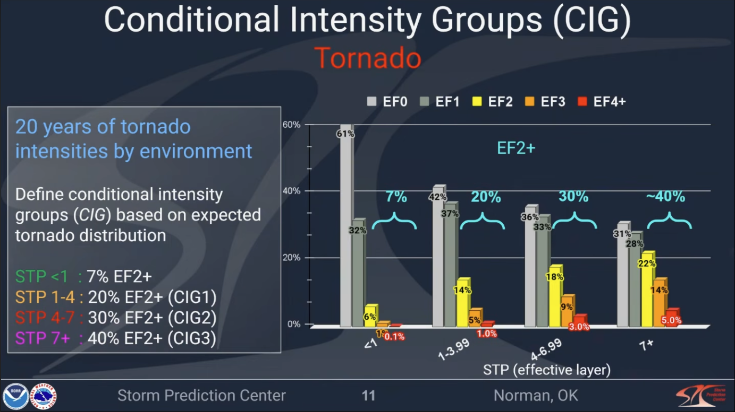
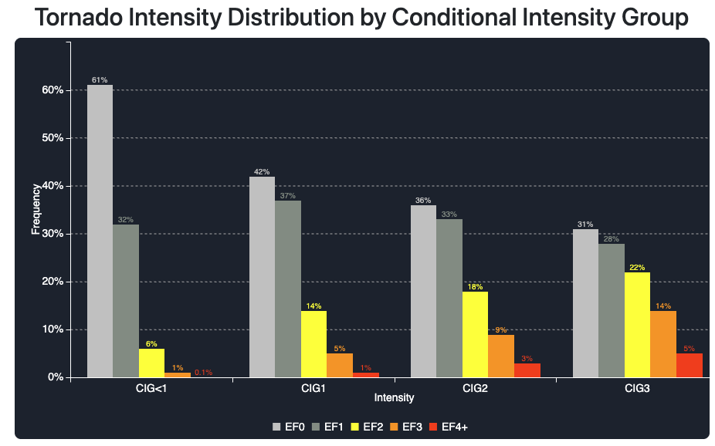
Conditional Intensity Forecasts
Notes:
Based on parameter space alone, the 2% tornado threat appears appropriate.

Slide 40
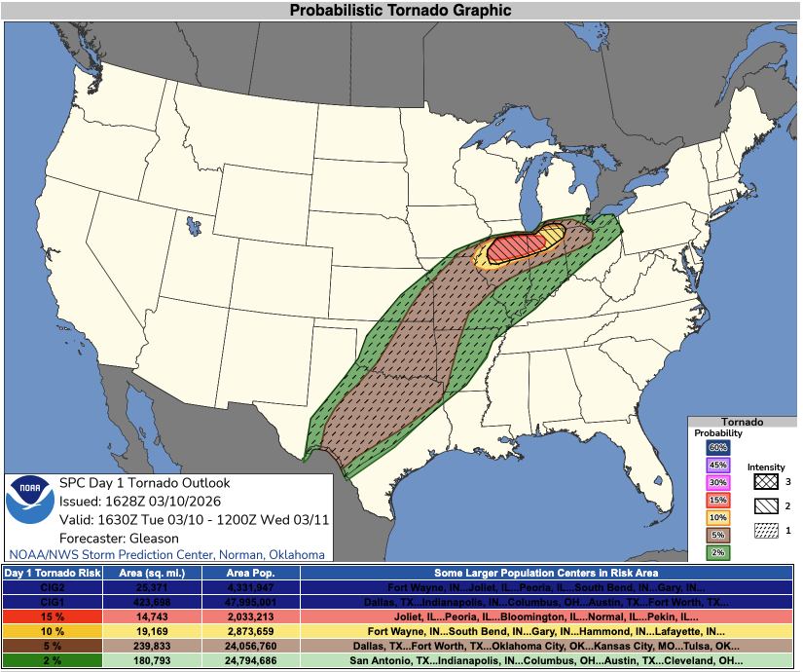
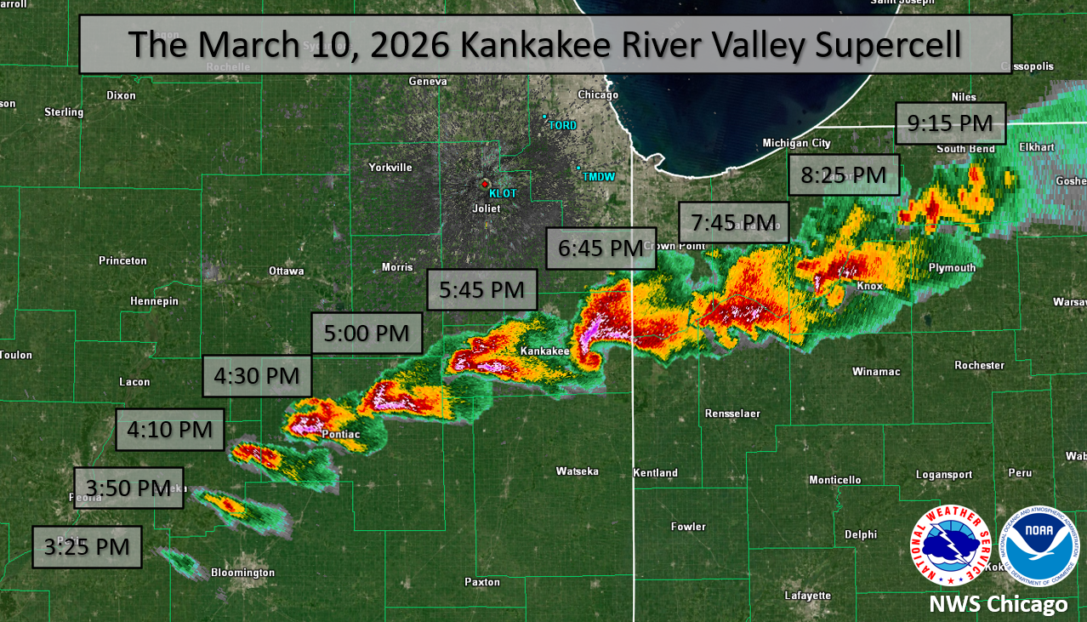
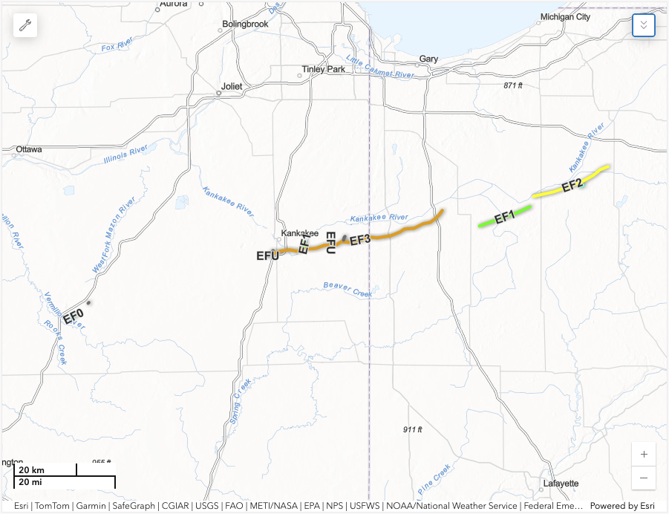
Conditional Intensity Forecast Example: 10 March 2026
Notes:
Based on parameter space alone, the 2% tornado threat appears appropriate.

Slide 41
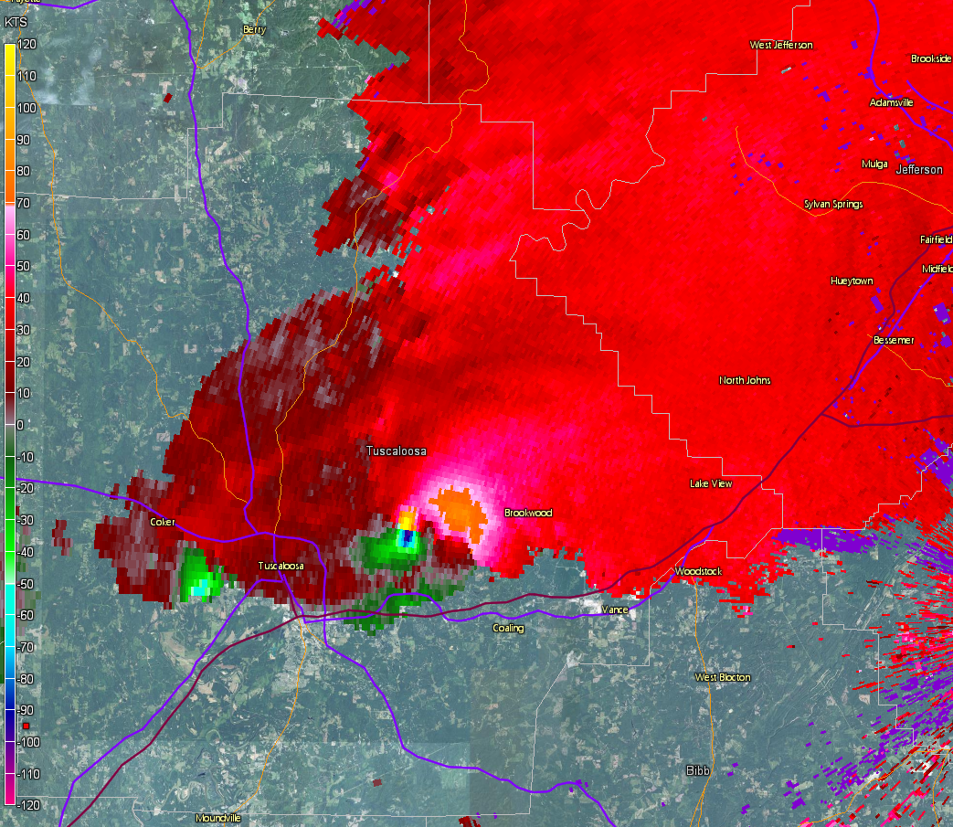
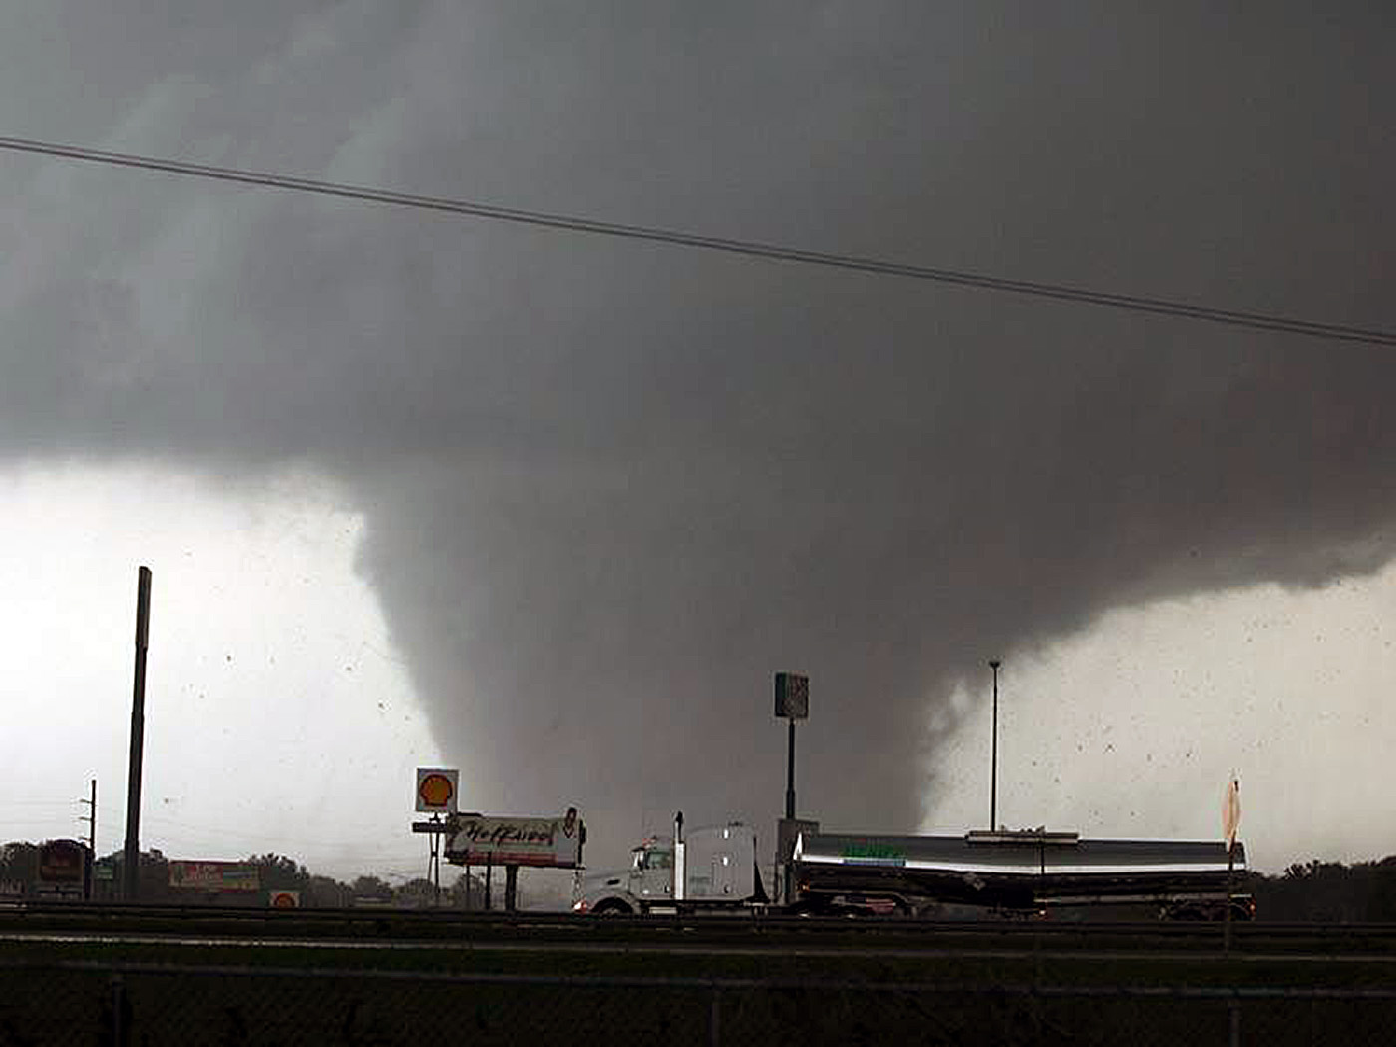
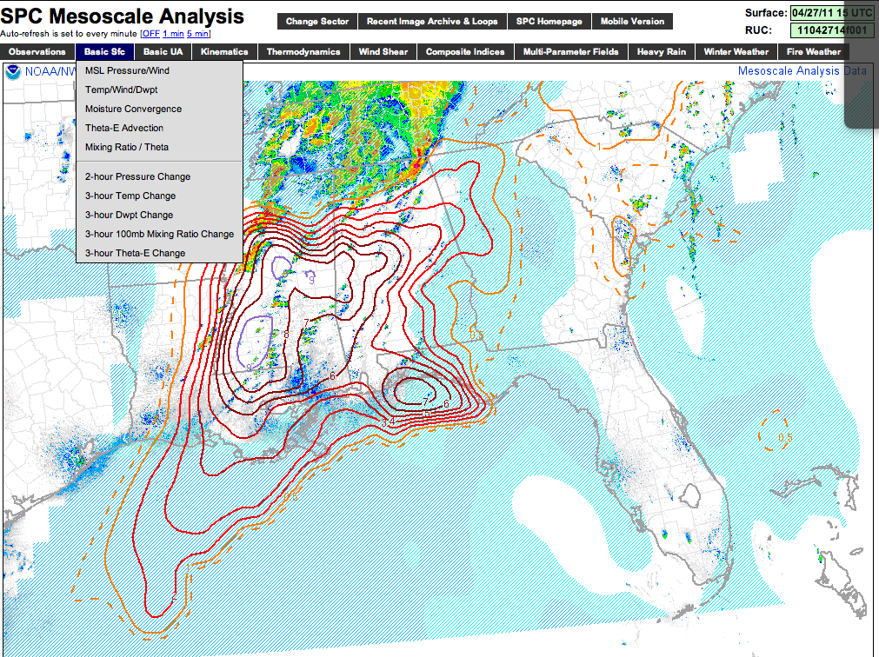
Questions?
Notes:
Based on parameter space alone, the 2% tornado threat appears appropriate.

Slide 42
Bonus material

Slide 43
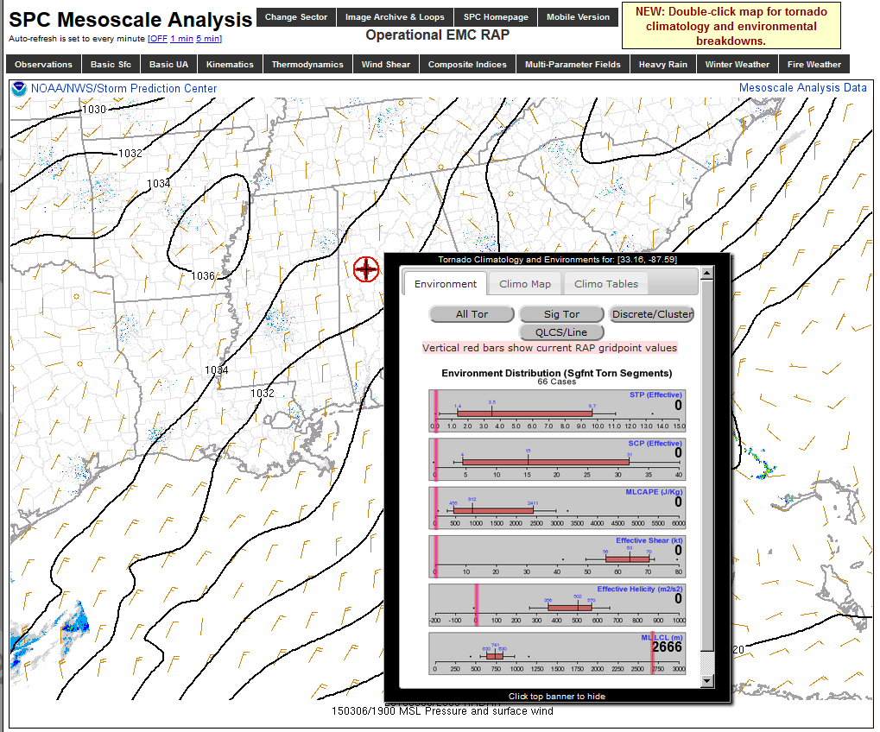
Notes:
Based on parameter space alone, the 2% tornado threat appears appropriate.

Slide 44
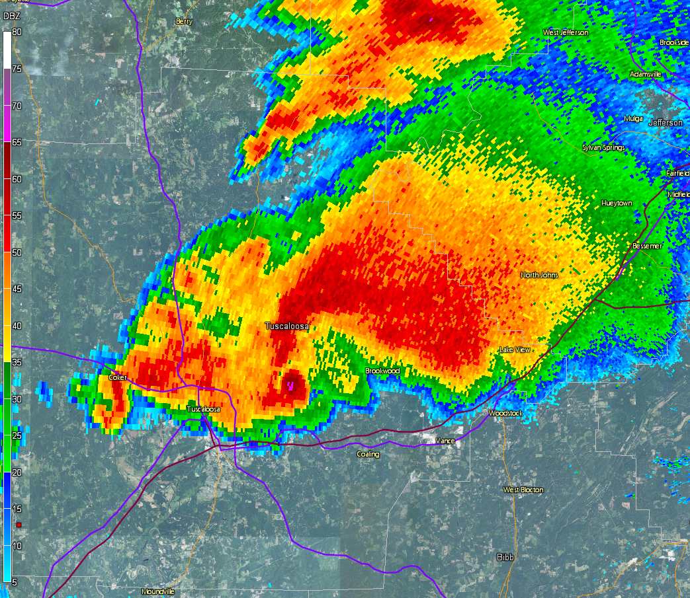
Notes:
Based on parameter space alone, the 2% tornado threat appears appropriate.

Slide 45
Notes:
Based on parameter space alone, the 2% tornado threat appears appropriate.

Slide 46
April 27, 2011 Tuscaloosa, AL EF-4
Notes:
Based on parameter space alone, the 2% tornado threat appears appropriate.

Slide 47
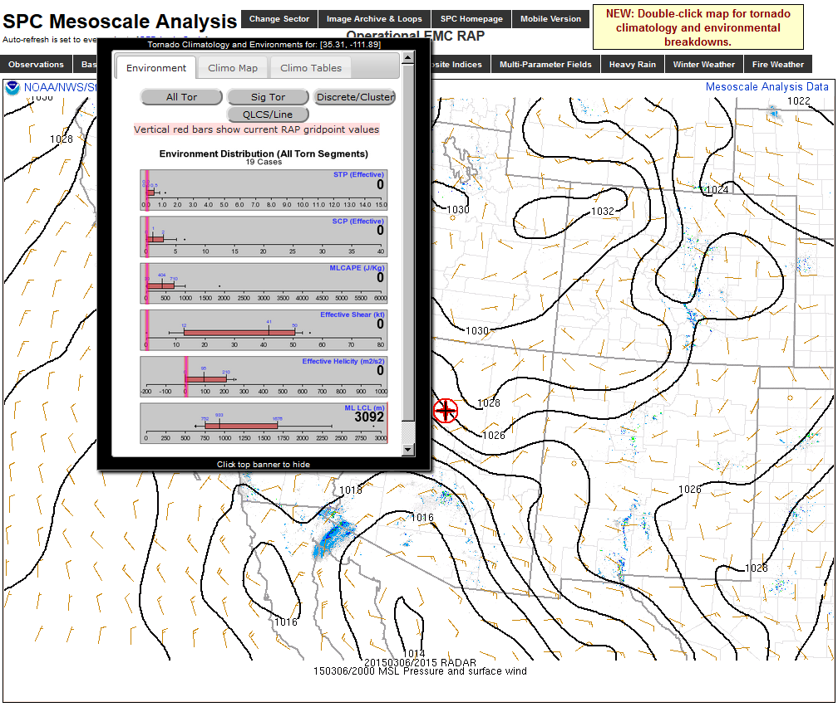
Notes:
Based on parameter space alone, the 2% tornado threat appears appropriate.

Slide 48
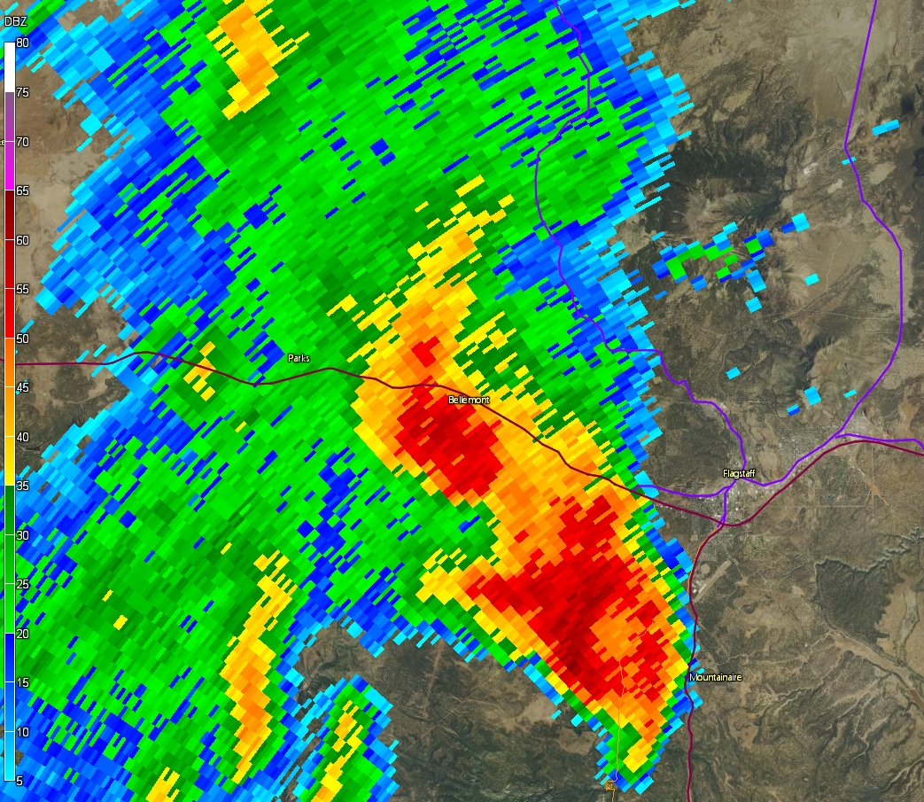
Notes:
Based on parameter space alone, the 2% tornado threat appears appropriate.

Slide 49
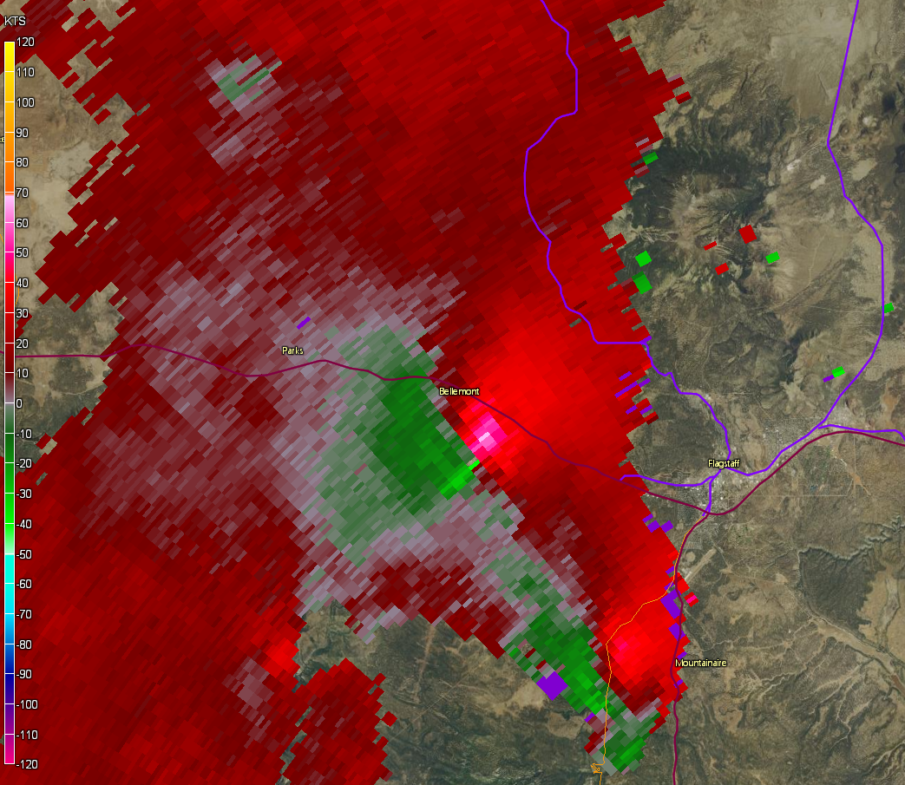
Notes:
Based on parameter space alone, the 2% tornado threat appears appropriate.

Slide 50
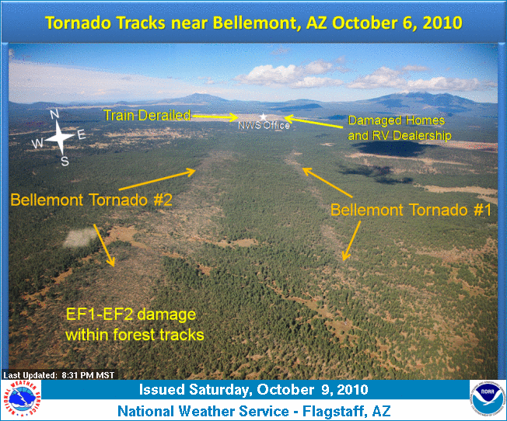
Bellemont, AZ
EF-2
Doesn’t just apply to high-end Plains/SE Environments!
Convective parameter magnitudes are relative to location/season.
Notes:
Based on parameter space alone, the 2% tornado threat appears appropriate.

Slide 51
Estimating Tornado Probability & Intensity in Real Time
Notes:
Based on parameter space alone, the 2% tornado threat appears appropriate.

Slide 52
Estimating Tornado Probability & Intensity in Real Time
Recent studies have shown that observed WSR-88D and environmental trends can yield reasonable probabilities of tornado occurrence and intensity in real time.
Smith et al. 2015 (WAF)
Thompson et al. 2017 (WAF)
Cohen et al. 2018 (WAF)
Smith et al. 2020 (parts 1 & 2) (WAF)
Recent studies by SPC featured:
~4700 tornadoes from 2009-2013
~10500 severe events & tornadoes from 2014
Tornado events required credible report or TDS
Environmental data, such as STP, also collected
Used 2009-2014 tornadoes to create conditional probabilities by EF scale
Used 2014-2015 tornadoes and severe events to create unconditional probabilities by EF scale.
Notes:
Based on parameter space alone, the 2% tornado threat appears appropriate.

Slide 53
Tornado Detection Via WSR-88D
Combined radar attributes (same place and time)
Storm-relative velocity (V_{rot} > ~40 kt)
Stronger and deeper 🡺higher EF2+ probability
Correlation coefficient < 0.8
More obvious and deeper 🡺higher EF2+ probability
Reflectivity > 20 dbZ (can include “debris ball”)
Low ZDR
Radar signatures combined with expectation based on storm environment

Slide 54


Step 3: Find Vrot
Vrot Example
0.5º
0.5º
0.5º
0.5º
Rotational Velocity (Vrot) = (Max Inbound + Max Outbound) /2
Notes:
Based on parameter space alone, the 2% tornado threat appears appropriate.

Slide 55
A Quick Note on WSR-88D Tornado Signatures
0.5º
0.5º
0.5º
0.5º
Notes:
Based on parameter space alone, the 2% tornado threat appears appropriate.

Slide 56
A Quick Note on WSR-88D Tornado Signatures
0.5º
0.5º
0.5º
0.5º
Notes:
Based on parameter space alone, the 2% tornado threat appears appropriate.

Slide 57
A Quick Note on WSR-88D Tornado Signatures
Inbound Velocity
0.5º
0.5º
Outbound Velocity
0.5º
0.5º
Notes:
Based on parameter space alone, the 2% tornado threat appears appropriate.

Slide 58
A Quick Note on WSR-88D Tornado Signatures
Max (realistic) Inbound
0.5º
0.5º
Max (realistic) Outbound
0.5º
0.5º
Rotational Velocity (Vrot) = (Max Inbound + Max Outbound) /2
Notes:
Based on parameter space alone, the 2% tornado threat appears appropriate.

Slide 59
A Quick Note on WSR-88D Tornado Signatures
0.5º
0.5º
CC minimum/Tornadic Debris Signature (TDS)
0.5º
0.5º
Heavier, non-uniform FFD precip
(likely contains hail)
Light, uniform inflow precipitation
Notes:
Based on parameter space alone, the 2% tornado threat appears appropriate.

Slide 60
A Quick Note on WSR-88D Tornado Signatures
0.5º
0.5º
TDS noted in ZDR
0.5º
0.5º
Notes:
Based on parameter space alone, the 2% tornado threat appears appropriate.

Slide 61
Step 1: Identify a velocity couplet
0.5º
0.5º
0.5º
0.5º
Notes:
Based on parameter space alone, the 2% tornado threat appears appropriate.

Slide 62
Step 2: Note distance between maxima (closer = better)
0.5º
0.5º
0.5º
0.5º
Notes:
Based on parameter space alone, the 2% tornado threat appears appropriate.

Slide 63
Step 3: Find Vrot
0.5º
0.5º
0.5º
0.5º
Rotational Velocity (Vrot) = (Max Inbound + Max Outbound) /2
Notes:
Based on parameter space alone, the 2% tornado threat appears appropriate.

Slide 64
Step 4: Note beam height/distance from radar
0.5º
0.5º
To RDA
0.5º
0.5º
Notes:
Based on parameter space alone, the 2% tornado threat appears appropriate.

Slide 65
Step 5: Check for TDS
0.5º
0.5º
0.5º
0.5º
Notes:
Based on parameter space alone, the 2% tornado threat appears appropriate.

Slide 66

Step 6: Check TDS Height
0.5º
1.3º
0.5º
1.3º
0.5º
1.3º
0.5º
1.3º
Notes:
Based on parameter space alone, the 2% tornado threat appears appropriate.

Slide 67



Step 7: Check Conditional Tornado Probs
Valid for this range
These are conditional probabilities:
You know a tornado is occurring
(TDS)
76% EF2+
44% EF3+
Louisville, MS EF4
28 April 2014
10 fatalities
10% EF4+
Notes:
Based on parameter space alone, the 2% tornado threat appears appropriate.

Slide 68
Unconditional Tornado Probabilities
Often don’t know if a tornado is occurring in remote areas or at night
Must consider “null” cases with low-level storm rotation to develop unconditional tornado probabilities

Slide 69

Is a tornado occurring?
80% NULL
20% EF0+
10% EF1+

Slide 70

Combined Tornado Probabilities

Slide 71

Need to consider influences of beam height/range
Lower tornado probabilities with distant circulations sampled well above ground
Higher tornado probabilities with closer circulations sampled near the ground

Slide 72

For your awareness...

Slide 73
Even in the Plains there are radar gaps!

Slide 74

Variations by height ARL

Slide 75

Variations by height ARL

Slide 76

Variations by height ARL

Slide 77


Need to consider influences of circulation diameter
Lower tornado probabilities with broad circulations
Higher tornado probabilities with tight circulations
VS.

Slide 78

Variations by circulation diameter

Slide 79

Variations by circulation diameter

Slide 80

Variations by circulation diameter

Slide 81

Conditional Probs by Height ARL

Slide 82

Conditional Probs by Distance

Slide 83

Conditional Probs (TDS vs. No-TDS)

Slide 84

What about regional differences?

Slide 85
Need to consider storm environment
So far we’ve only considered WSR-88D signatures, but the env can help!
Try to keep the environment estimate simple
Look at significant tornado parameter (STP)
Take max value within 80 km of each storm
Forecasters consider more than a point value!

Slide 86
Tornado Probabilities by Vrot

Slide 87

Tornado Probabilities by Eff. STP

Slide 88

Increasing EF2+ probabilities

Slide 89

Tornado Probabilities by Eff. STP
Available at http://arctic.som.ou.edu/tburg/products/R2O/torprob/
Try it yourself!
Tornado probability tool developed by Tomer Burg.
Based on research outlined in Cohen et al. 2018

Slide 90

0.5º
2236z

Slide 91

0.5º
2238z

Slide 92

0.5º
2241z

Slide 93

0.5º
2244z

Slide 94

0.5º
2246z

Slide 95

0.5º
2249z

Slide 96
0.5º
2249z

Slide 97
0.5º
V_{rot} = 69 kt
2249z

Slide 98
0.5º
Inflow Notch
Inflow Notch
Inflow Notch
2249z

Slide 99

0.5º
0.9º
Inflow Notch
Inflow Notch
Inflow Notch
2249z
2249z

Slide 100


Step 7: Check Conditional Tornado Probs
Valid for this range
These are conditional probabilities:
You know a tornado is occurring
(TDS)
57% EF2+
26% EF3+
6% EF4+
McMullen, AL EF2
2 February 2016
Notes:
Based on parameter space alone, the 2% tornado threat appears appropriate.

Slide 101


Slide 102


